Slide 2
BIO ESSENCES FOR THE SKIN –
A NEW SOLUTION IN COSMETOLOGY
More than just a serum!
The molecular composition of these pure essences fully corresponds to that of living plants, providing 100% of the active ingredients to the skin.
You can add a few drops of the essence to your favorite skincare products or apply only the essence.

Slide 3
The unique technology of supercritical CO2 extraction allows real biological “copies” of living plants to be obtained which provide maximum skincare benefits.
These purest phyto essences are 100% natural, and free of extractants, impurities and additives.
A molecular “twin” of living plants
100% natural
Vegan friendly

Slide 4
TECHNOLOGY
CO2 extraction is a very gentle way of producing the most concentrated herbal extracts maintaining all their benefits. Physiologically safe supercritical carbon dioxide penetrates the herbal material better, absorbs and then delivers the extracted substances.
This method extracts essences which are perfect copies of the natural material. At the same time they do not contain any traces of solvent, inorganic salts, or microorganisms. This is not possible using other, traditional extraction methods.
The skin absorbs such essences naturally and this allows them to penetrate deeper into the skin. As a result the essences act gently but give a noticeable effect.

Slide 5
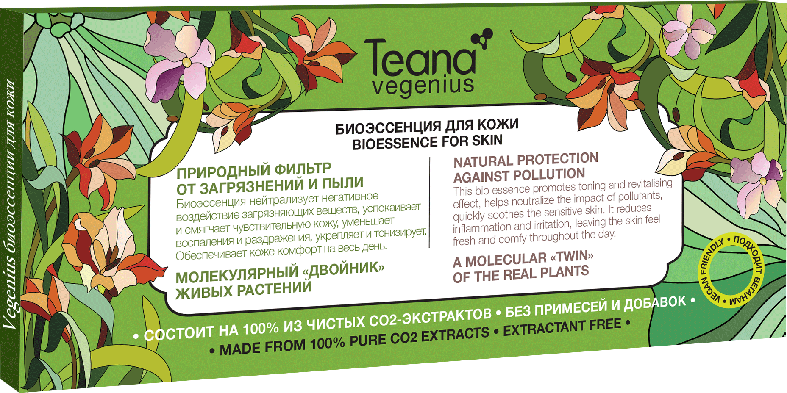
NATURAL PROTECTION
against pollution
This bio essence has a toning and revitalizing effect, helping neutralize the impact of pollutants. It soothes sensitive skin, reduces inflammation and irritation, making the skin feel fresh and comfortable throughout the day.
• soothing
• toning
• providing protection
Ingredients: the essences of hypericum, tussilago farfara, echinacea, birch leaves, pomegranate, cucumber, dandelion, ficus, and rhododendron.
One pack volume: 10*2ml
Packs in a carton: 100
Manufactured in: Russia
Shelf life: 24 months

Slide 6
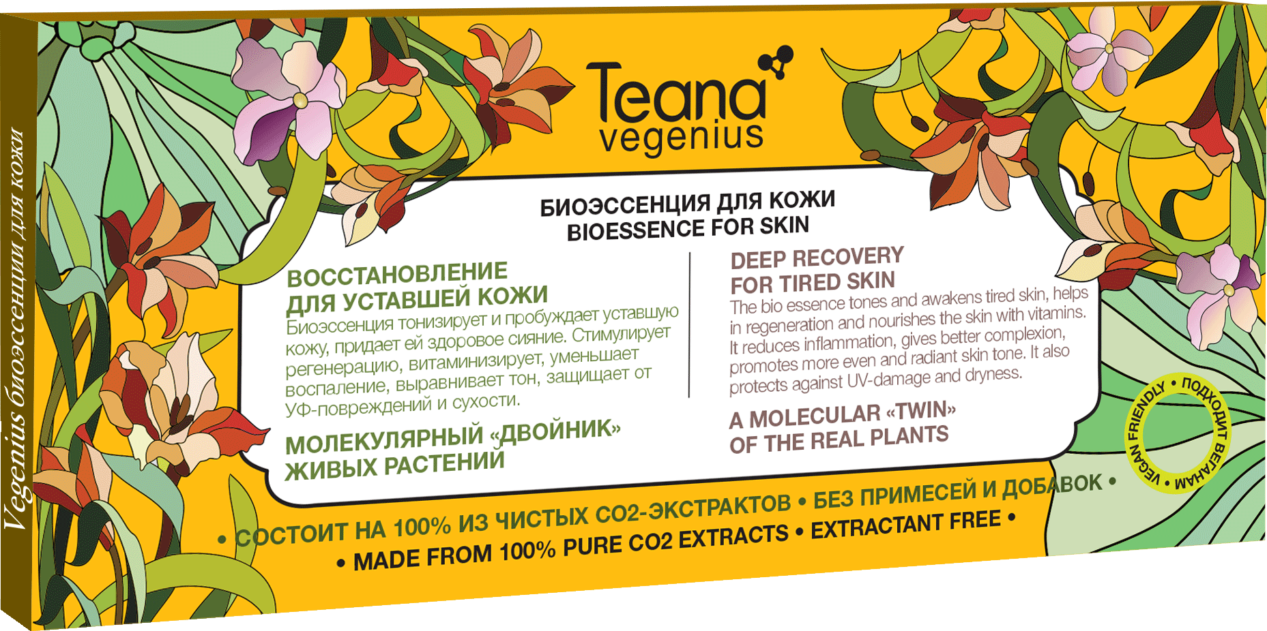
DEEP RECOVERY
for tired skin
This bio essence tones and awakens tired skin, regenerating and nourishing it with vitamins. It reduces inflammation, evens out the complexion, and gives a healthy radiance. It also protects against UV-damage and dryness.
• improving complexion
• wiping off the signs of fatigue
• moisturizing
Ingredients: essences of Cucumis sativa (cucumber), Juglans regia (walnut), Fucus vesiculosis, Urtica dioica (nettle), Thea camellia sinensis, Panax ginseng, Mimosa pudica, Coffea arabica, Arnica montana, Oenothera biennis.
One pack volume: 10*2ml
Packs in a carton: 100
Manufactured in: Russia
Shelf life: 24 months

Slide 7
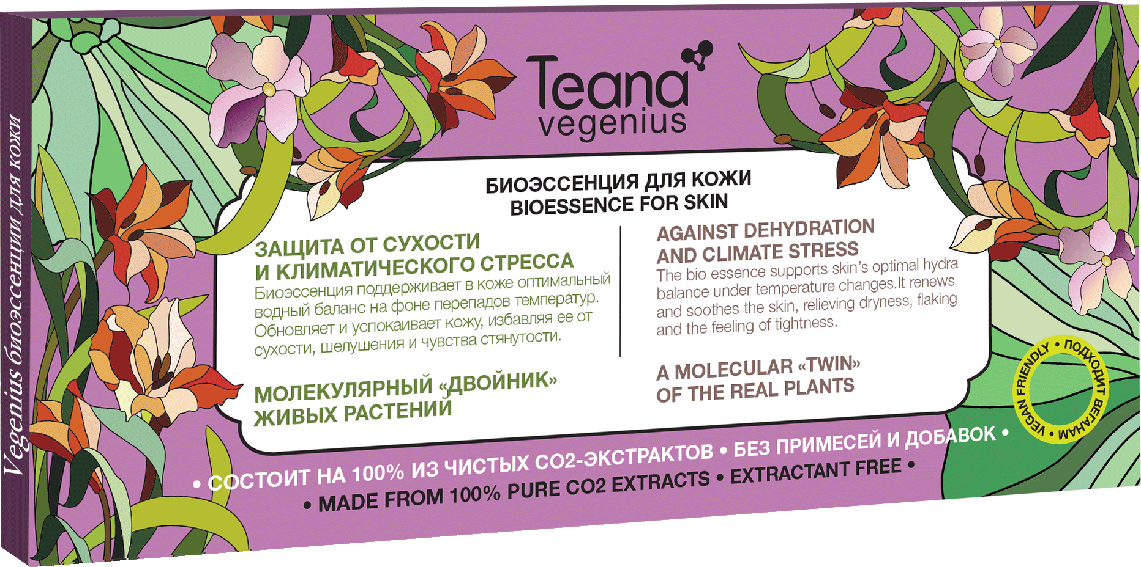
AGAINST DEHYDRATION
and climate stress
This bio essence maintains the skin’s optimal moisture balance amid temperature changes. It renews and soothes the skin, eliminating dryness, flaking and any feeling of tightness. It also provides antioxidant protection, reduces inflammation and has a rejuvenating effect.
• moisturizing deeply
• eliminating dryness
• soothing and protecting
Ingredients: essences of Rosmarinus, Melilotus, Vitis vinifera (grape), Aloe, Thea sinensis (tea), Trifolium arvense (clover), Centauerea cyanis, Leuzea carthamoides, Echinacea purpurea, Monarda fistusola.
One pack volume: 10*2ml
Packs in a carton: 100
Manufactured in: Russia
Shelf life: 24 months

Slide 8
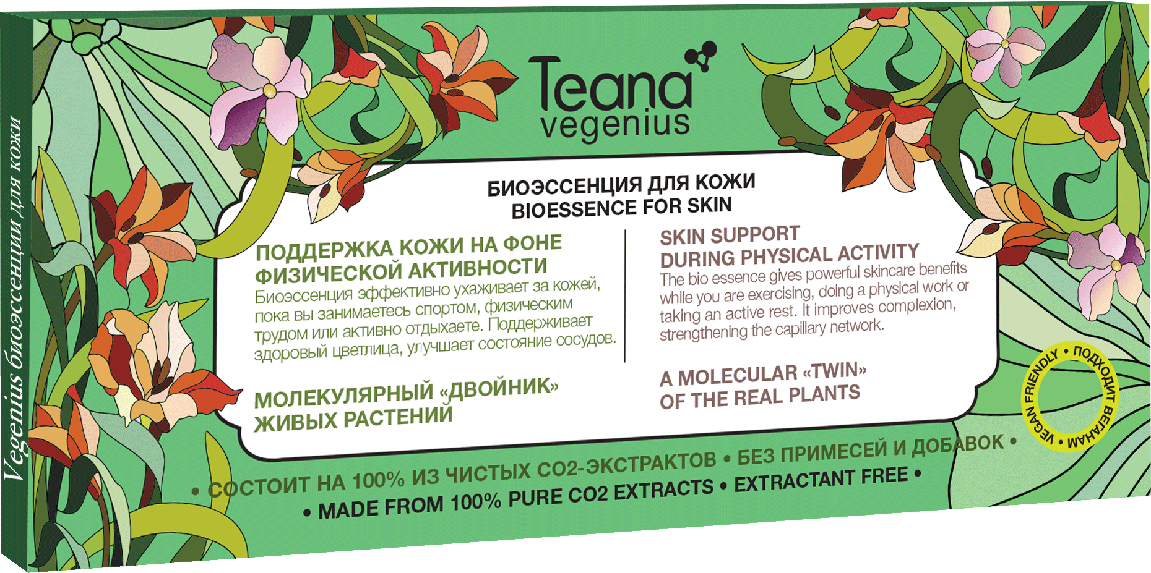
SKIN SUPPORT
during physical activity
This bio essence gives you powerful skincare benefits while you are working out or just working hard. It keeps your complexion healthy and strengthens the capillary network. It also regulates sebaceous glands activity, protecting the skin from irritation and redness.
• protecting from irritation
• strengthening capillaries
• normalizing sebaceous glands activity
Ingredients: the essences of Fucus vesiculosis, Sprirulina platensis, Hamamelis virginiana, Olea europaea, Lavandula, Aegopodium podagraria, Vaccinium myrtillus, Triticum vulgare, Acacia arabica, Zingiber.
One pack volume: 10*2ml
Packs in a carton: 100
Manufactured in: Russia
Shelf life: 24 months

Slide 9
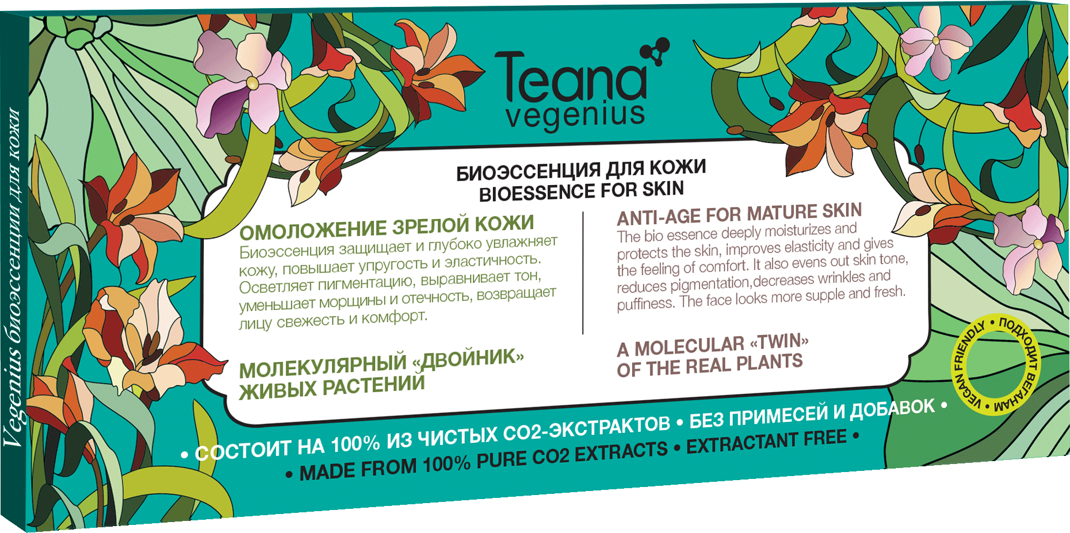
ANTI-AGE
for mature skin
This bio essence deeply moisturizes and protects the skin, improving its elasticity and giving a feeling of comfort. It evens out the skin tone, fights pigmentation and reduces wrinkles and puffiness, making your skin look fresher and more supple. It also has an antioxidant and anti-inflammatory effects.
• smoothing wrinkles
• increasing suppleness
• reducing puffiness
Ingredients: the essences of Rubus idaeus (raspberry), Malus pumila (apple), Vitis vinifera (grape), Viburnum opulis, Betula verrycosa, Cinnamomum cassia, Hippophae rhamnoides, Amaranthus cruentus, Leontopodium alpinum, Prostopinum.
One pack volume: 10*2ml
Packs in a carton: 100
Manufactured in: Russia
Shelf life: 24 months

Slide 10
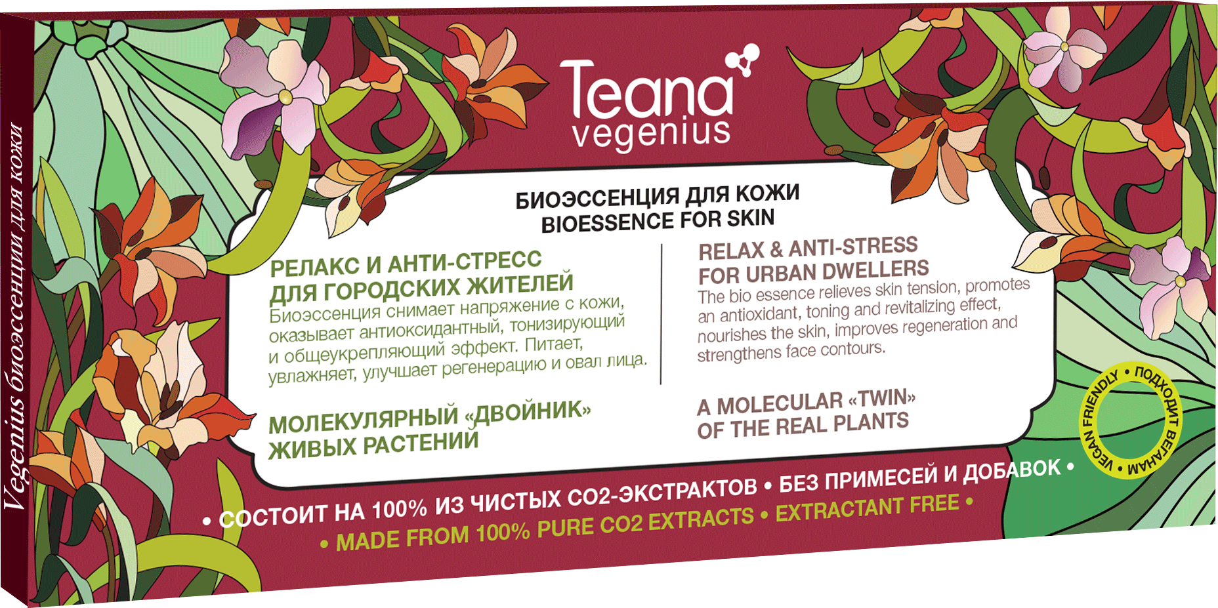
RELAX & ANTI-STRESS
for urban dwellers
This bio essence relieves skin tension and has an antioxidant, toning and revitalizing effect. It nourishes and moisturizes the skin, improving its regeneration and firming facial contours. It normalizes the sebaceous glands’ activity, reducing inflammation, redness and dryness.
• nourishing and strengthening
• relieving the tension
• protecting from stress
Ingredients: the essences of Silybum marianum, Sesamum, Solanum lycopersicum (tomato), Citrus sinensis (orange), Citrus limonum (lemon), Citrus aurantifolia (lime), Ribes nigrum (blackcurrent), Lonicera, Centella asiatica, Bambusa aurundinavia.
One pack volume: 10*2ml
Packs in a carton: 100
Manufactured in: Russia
Shelf life: 24 months

Slide 11
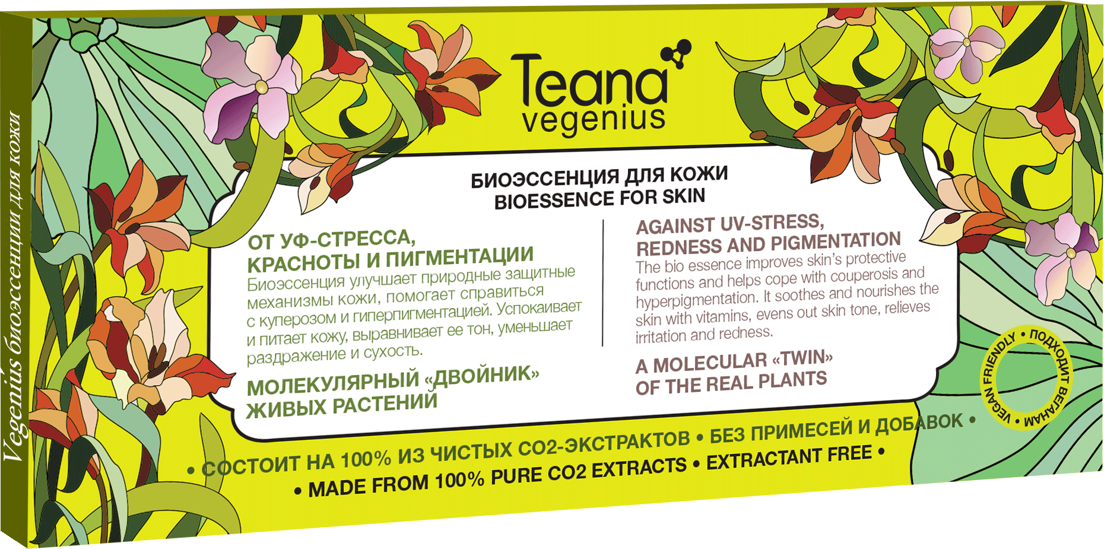
AGAINST UV-STRESS,
redness and pigmentation
This bio essence improves the skin’s protective functions and helps it cope with couperosis and hyperpigmentation. It soothes, nourishes the skin with vitamins, evens out skin tone, and relieves irritation and redness.
• evening out the tone
• eliminating redness
• regenerating
Ingredients: the essences of Morus nigra, Ahuacatl, Rubus idaeus, Cocos, Thea sinensis (tea), Spinacia oleracea, Curcuma longa, Petroselinum crispum (parsley), Daucus carota (carrot), Scutellaria baicalensis.
One pack volume: 10*2ml
Packs in a carton: 100
Manufactured in: Russia
Shelf life: 24 months

Slide 12
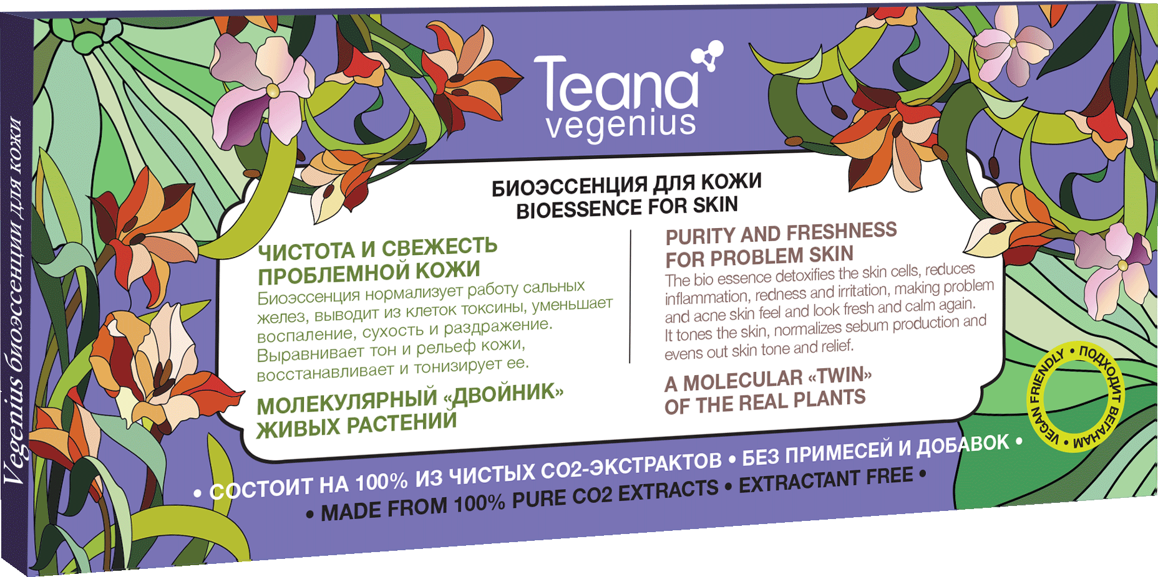
PURITY AND FRESHNESS
for problem skin
This bio essence detoxifies the skin cells, reduces inflammation, redness and irritation, making problem and acne skin feel and look fresh and calm again. It tones the skin, normalizes sebum production and evens out the skin’s tone and texture.
• detoxifying
• reducing inflammation
• regenerating
Ingredients: the essences of Oryza sativali (rice), Sphagnum, Chamaenerion angustifolium, Foeniculum Vulgare, Viola tricolor, Spiraea beauverdiana, Salix alba (willow), Elettaria Cardamomum, Chamomilla recutita.
One pack volume: 10*2ml
Packs in a carton: 100
Manufactured in: Russia
Shelf life: 24 months

Slide 13
BIO ESSENCES
FOR THE SKIN
Natural
Fresh
Potent

