Slide 1
Bioactive Ampouled Cosmetics

Slide 2
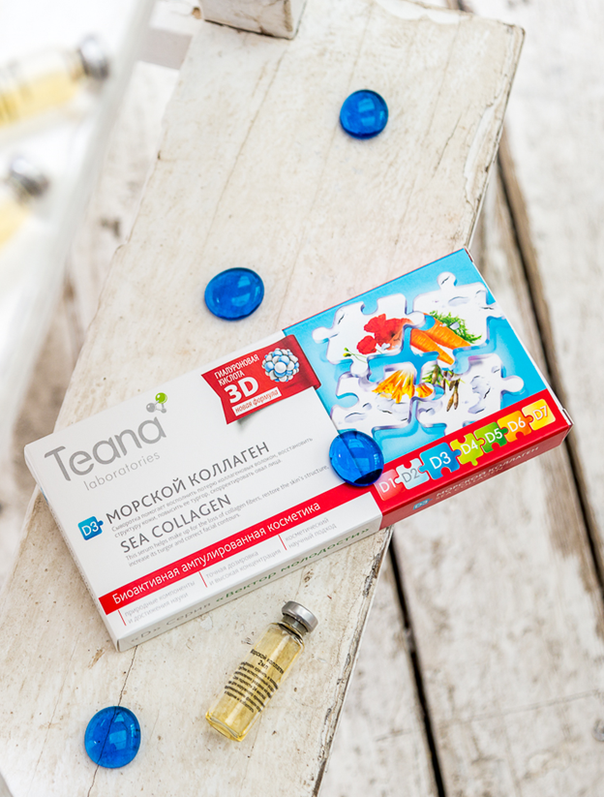
Advantages
1. Living cosmetics
Teana bioactive ampouled cosmetics contain only natural ingredients, are environmentally friendly and hypoallergenic.
2. Precise dosage
Each box contains 10 ampoules 2ml each. Disposable vials made of special pharmaceutical glass minimize the use of preservatives and guarantee freshness and potency.
3. Trendsetting
Teana was the first to introduce bioactive ampouled cosmetics to the Russian market in 2007, initially bringing out a line of five serums. We now have more than 30 SKUs in this line, sold worldwide (China, Vietnam, South Africa, Latvia, Kazakhstan; Amazon, Taobao)

Slide 3
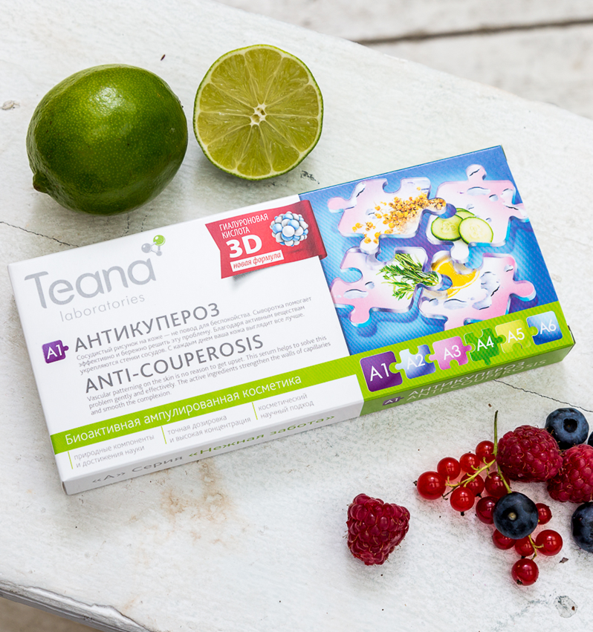
Advantages
4. Focused care
Each serum is intended to address a well-defined objective:
• Intensify skin hydration
• Restore the dermis
• Lighten age spots
• Reduce the appearance of couperosis
• Improve facial contours
• Reduce wrinkles
• Revive and restore problem skin
5. 3D hyaluronic acid gel
Teana 3D-hyaluronic acid combines three different sized molecules, thereby rapidly penetrating all layers of the skin, providing maximum moisturizing and helping targeted delivery of other active components.

Slide 4
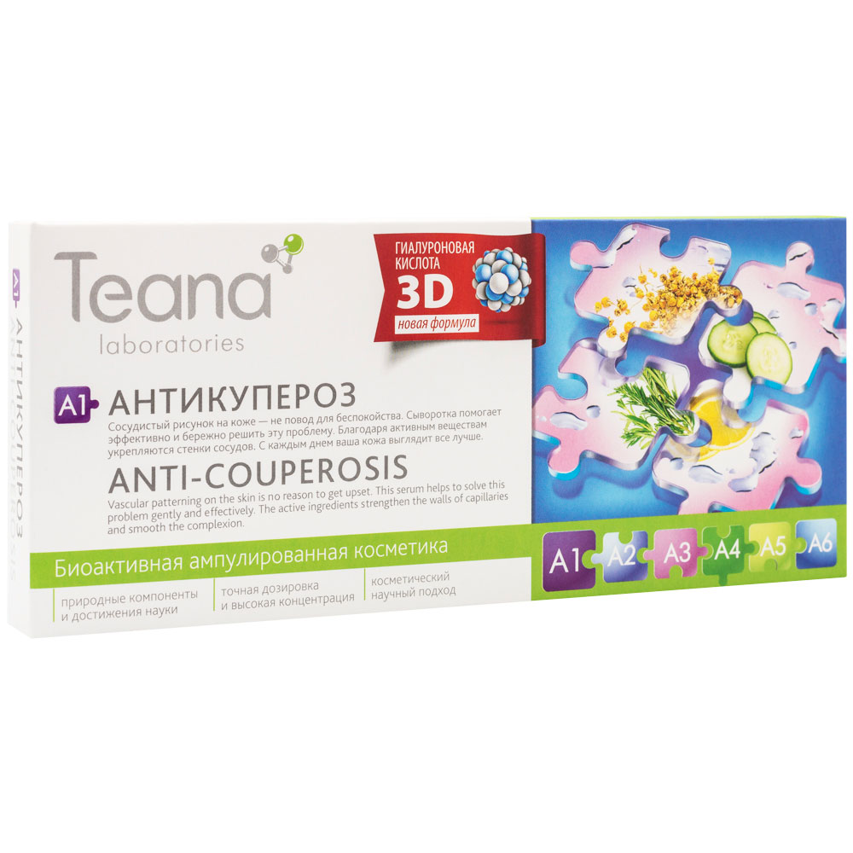
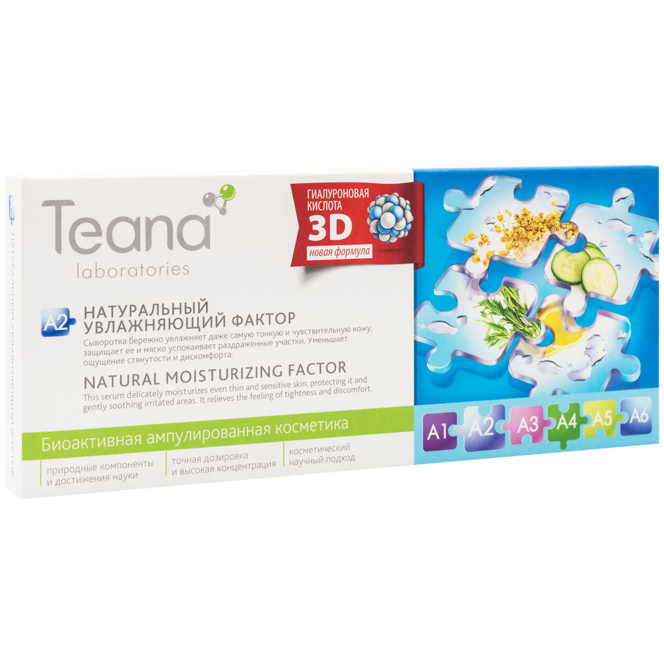
A – Gentle Care
A1. Anti-Couperosis
Skin condition: any skin type with couperosis, 18+
Effect: helps remove vascular patterning on the skin, reduces irritation and evens complexion.
Ingredients: hyaluronic acid gel (aqua, sodium hyaluronate), hop extract (Humulus lupulus), camomile extract (Chamomilla recutita), horse chestnut extract (Aesculus hippocastanum), witch hazel extract (Hamamelis virginiana), thyme extract (Thymus vulgaris), rosemary extract (Rosmarinus officinalis)
A2. Natural Moisturizing Factor *
Skin condition: all skin types, including sensitive, 18+
Effect: reduces small wrinkles, evens skin texture, helps alleviate flaking and redness.
Ingredients: hyaluronic acid gel (aqua, sodium hyaluronate), Japanese pagoda tree extract (Sophora japonica), Japanese seaweed extract (Laminaria japonica), Japanese honeysuckle extract (Lonicera japonica), Japanese apricot extract (Prunus mume), Japanese rose extract (Rosa rugosa), mondograss extract (Ophiopogon japonicus), rice oil (Oryza sativa).
*the symbol means the serum is suitable for eye contour application

Slide 5
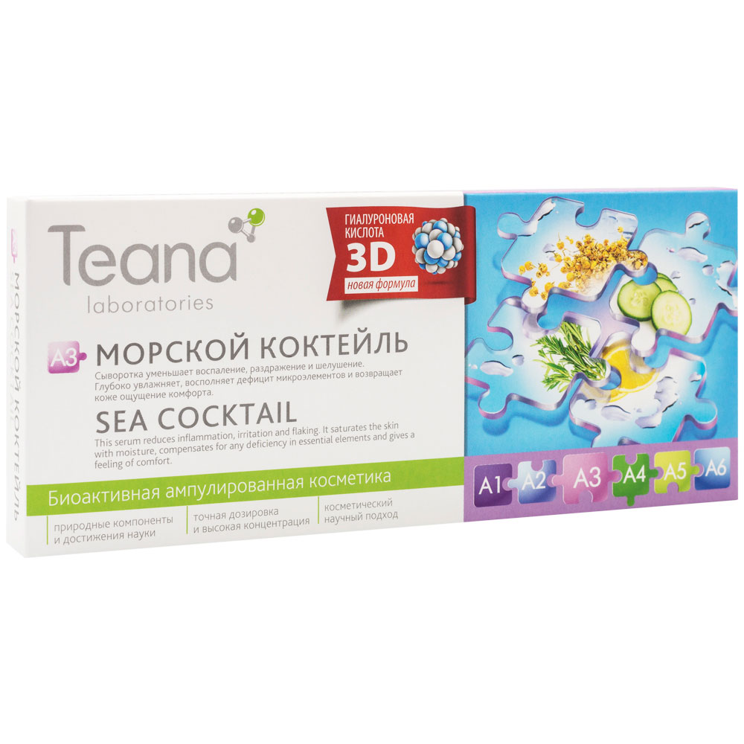
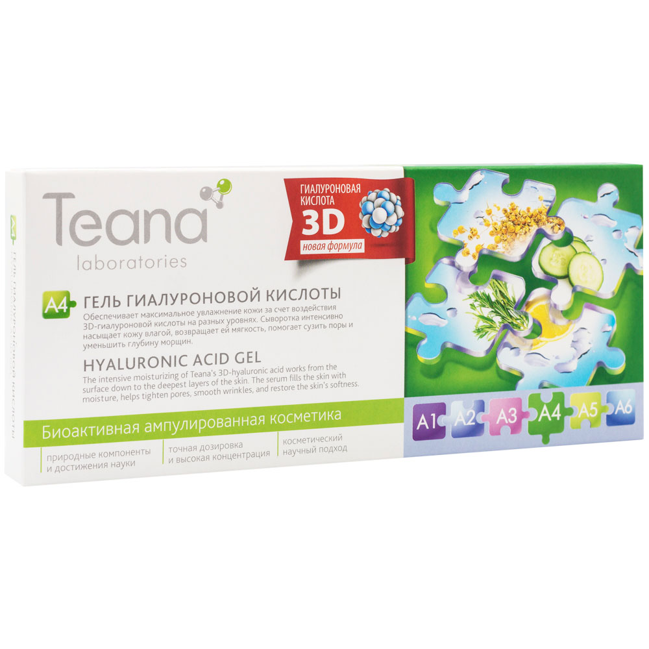
A – Gentle Care
A3. Sea Cocktail
Skin condition: all skin types with reduced turgor, 18+
Effect: provides intensive hydration, fills the skin with minerals.
Ingredients: hyaluronic acid gel (aqua, sodium hyaluronate), Japanese seaweed extract (Laminaria japonica).
A4. Hyaluronic Acid Gel
Skin type: all types of skin, 18+
Effect: provides moisture, softens fine lines and wrinkles, narrows enlarged pores.
!Works especially well in combination with a facial massage and noninvasive cosmetic appliances.
Ingredients: hyaluronic acid gel (aqua, sodium hyaluronate), Optiphen BD (Benzyl alcohol, Benzoic acid, Dehydroacetic acid).

Slide 6
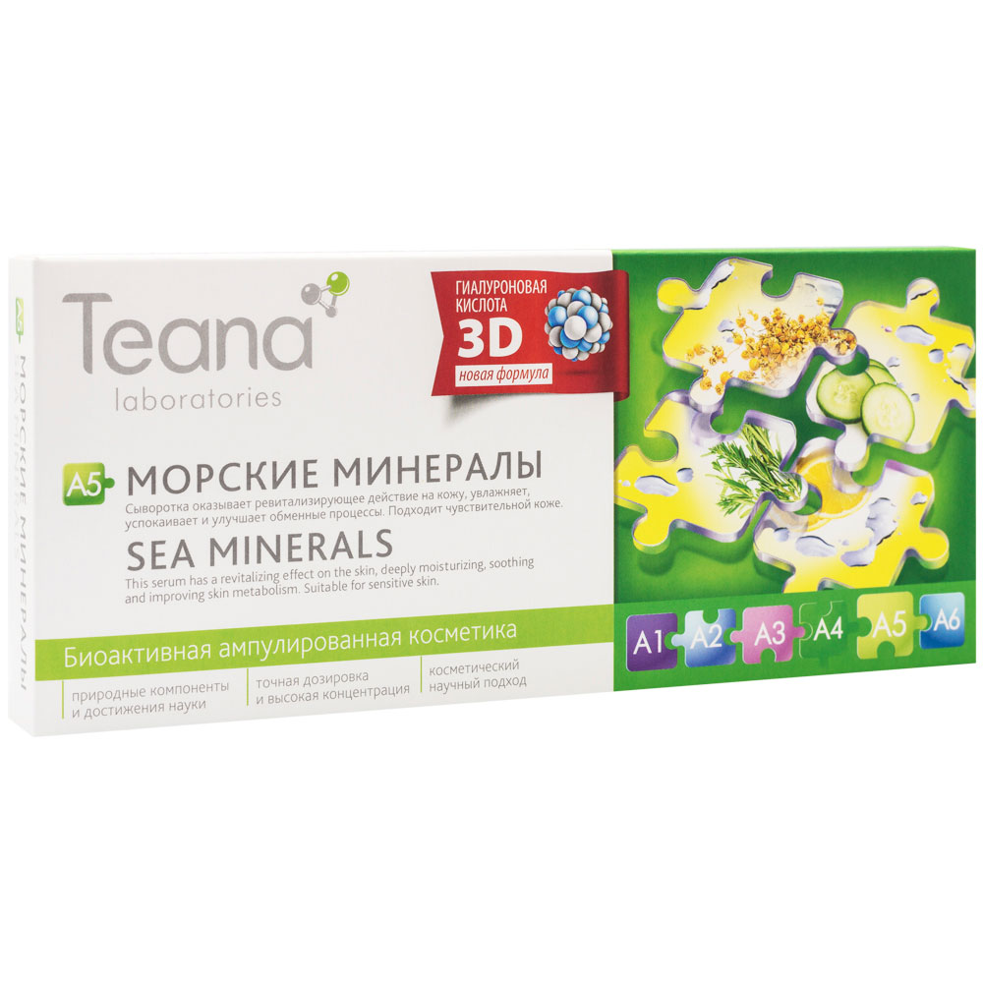
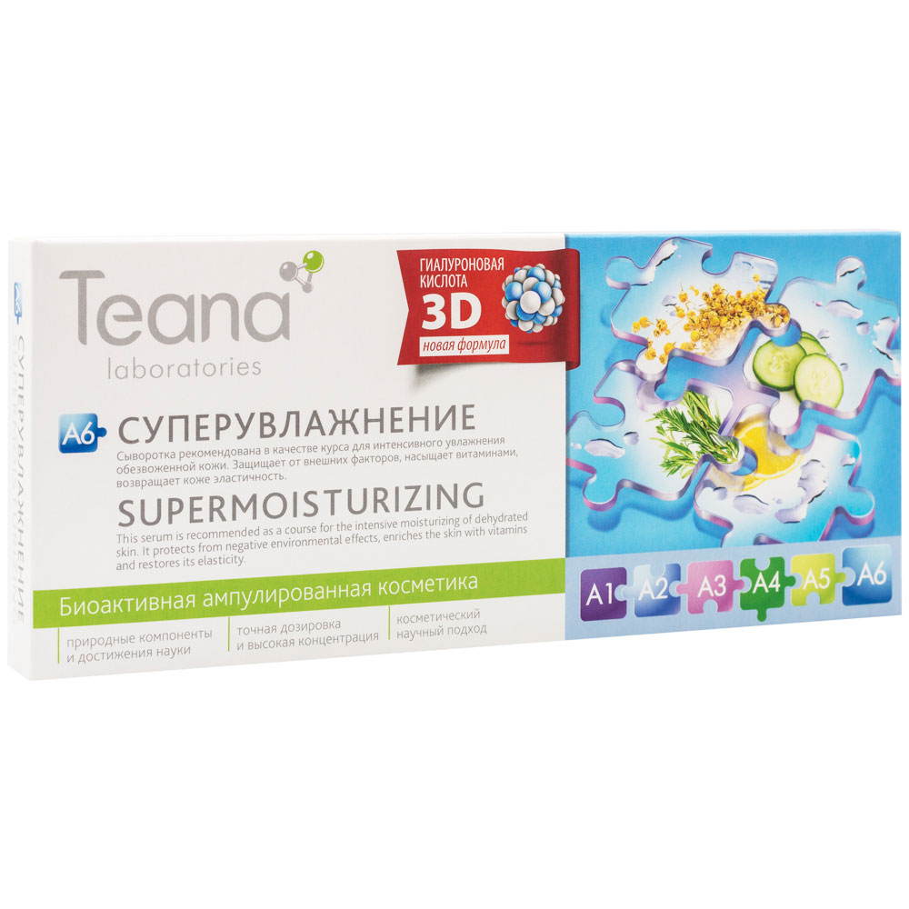
A – Gentle Care
A5. Sea Minerals
Skin condition: skin prone to dryness and allergy, 18+
Effect: has a revitalizing effect on the skin, deeply moisturizes, removing redness and peeling, narrows enlarged pores, helps improve skin metabolism.
Ingredients: hyaluronic acid gel (aqua, sodium hyaluronate), Dead sea salt (Maris sal).
A6. Supermoisturizing
Skin condition: extremely dehydrated, 18+
Effect: increases the protective properties of the skin, normalizes the moisture level in the deepest layers, soothes.
!Recommended in courses as an emergency response to dehydration and frequent exposure to the sun, as well as consequences of diets, stress and antibiotics.
Ingredients: hyaluronic acid gel (aqua, sodium hyaluronate), peach extract (Prunus persica), dog-rose extract (Rosa canina), cucumber extract (Cucumis sativus), barley extract (Hordeum vulgare), wild pansy extract (Viola tricolor).

Slide 7
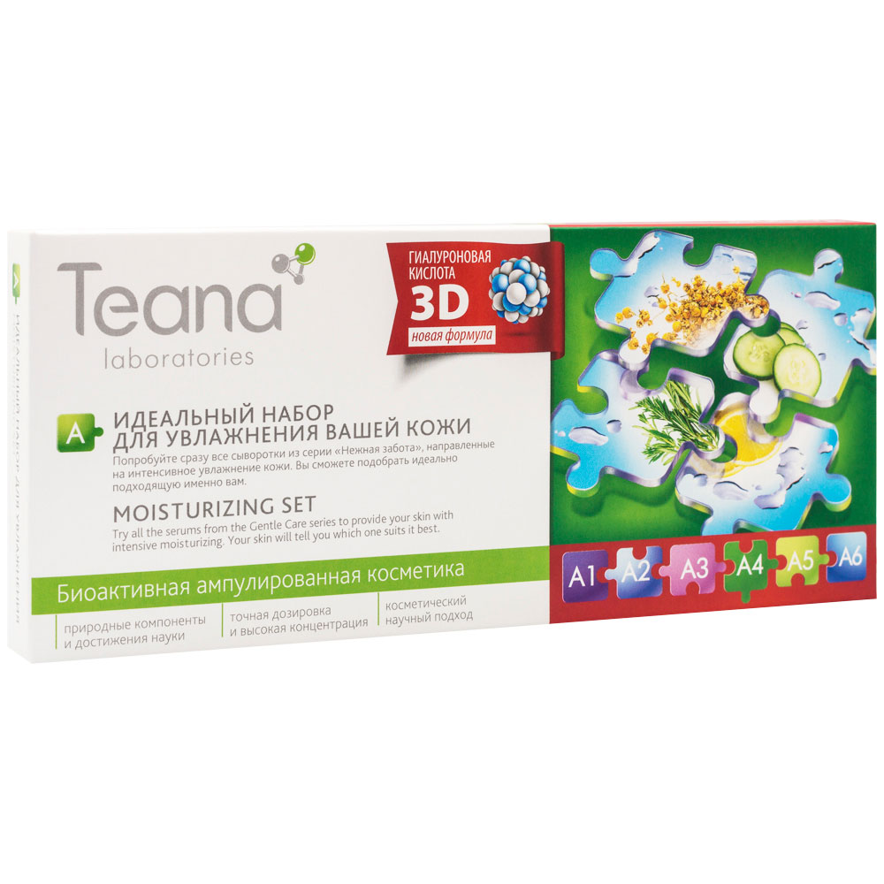
A – Gentle Care
A. MOISTURIZING SET
An ideal opportunity to try all of the variety of Teana intensive moisturizing serums and choose the best for the specific individual needs.
contains:
A2. Natural Moisturizing Factor – 2 ampoules
A3. Sea Cocktail – 2 ampoules
A4. Hyaluronic Acid Gel – 2 ampoules
A5. Sea Minerals – 2 ampoules
A6. Supermoisturizing – 2 ampoules

Slide 8
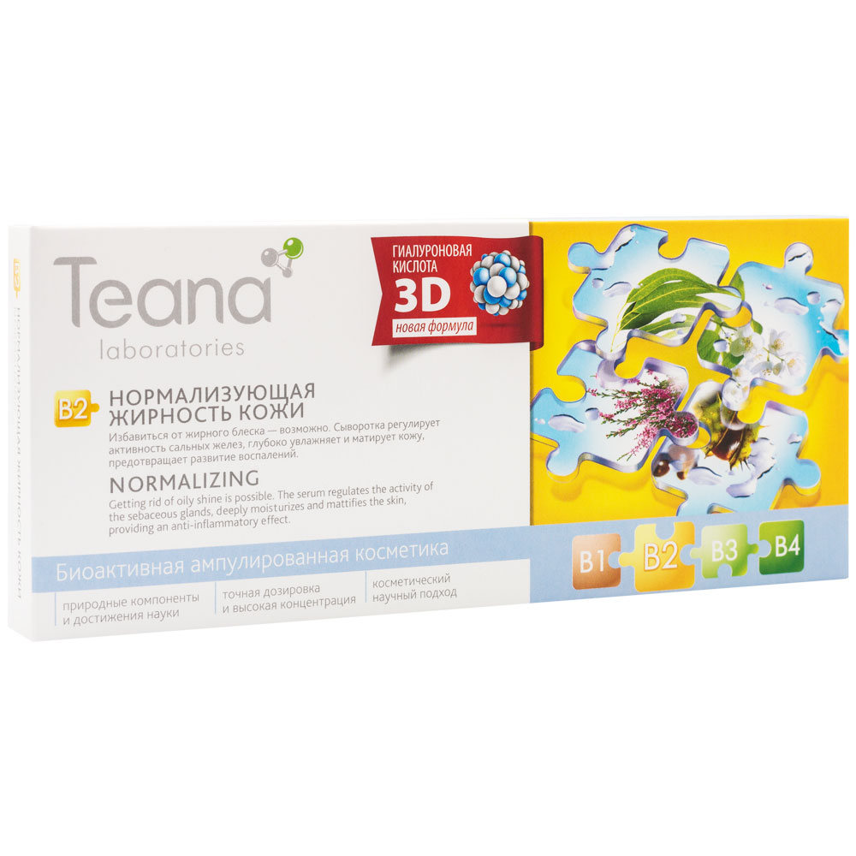
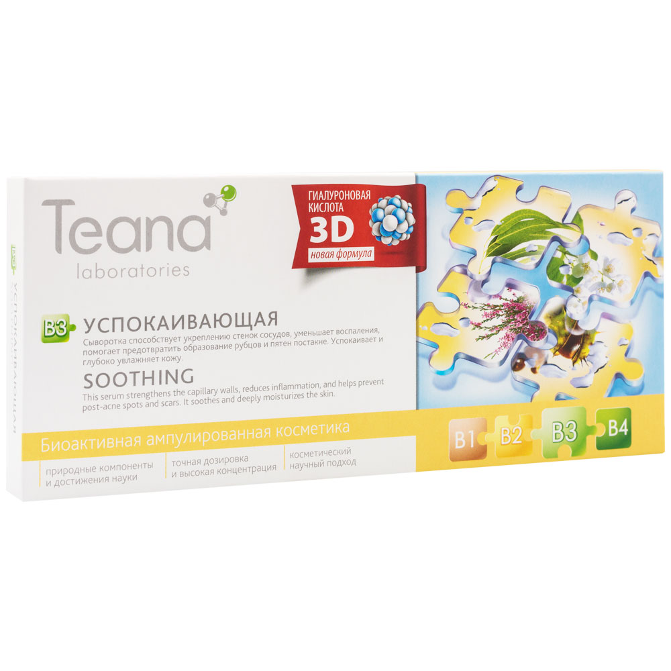
B – Secret of Matte Skin
B2. Normalizing
Skin type: oily and problem skin, 16+
Effect: regulates hyperactive sebaceous glands, removing oily luster, provides a durable anti-inflammatory and soothing effect.
Ingredients: hyaluronic acid gel (aqua, sodium hyaluronate), Tasmanian blue gum extract (Eucalyptus globulus), horse chestnut extract (Aesculus hippocastanum), stinging nettle extract (Urtica dioica).
B3. Soothing
Skin condition: prone to acne, 16+
Effect: promotes strengthening of capillary walls, prevents inflammation, helps fast healing and prevents post-acne marks.
Ingredients: hyaluronic acid gel (aqua, sodium hyaluronate), elderberry extract (Sambucus nigra), ginkgo extract (Ginkgo biloba), heather extract (Calluna vulgaris), rosemary extract (Rosmarinus officinalis), sage extract (Salvia officinalis), witch hazel extract (Hamamelis virginiana).

Slide 9
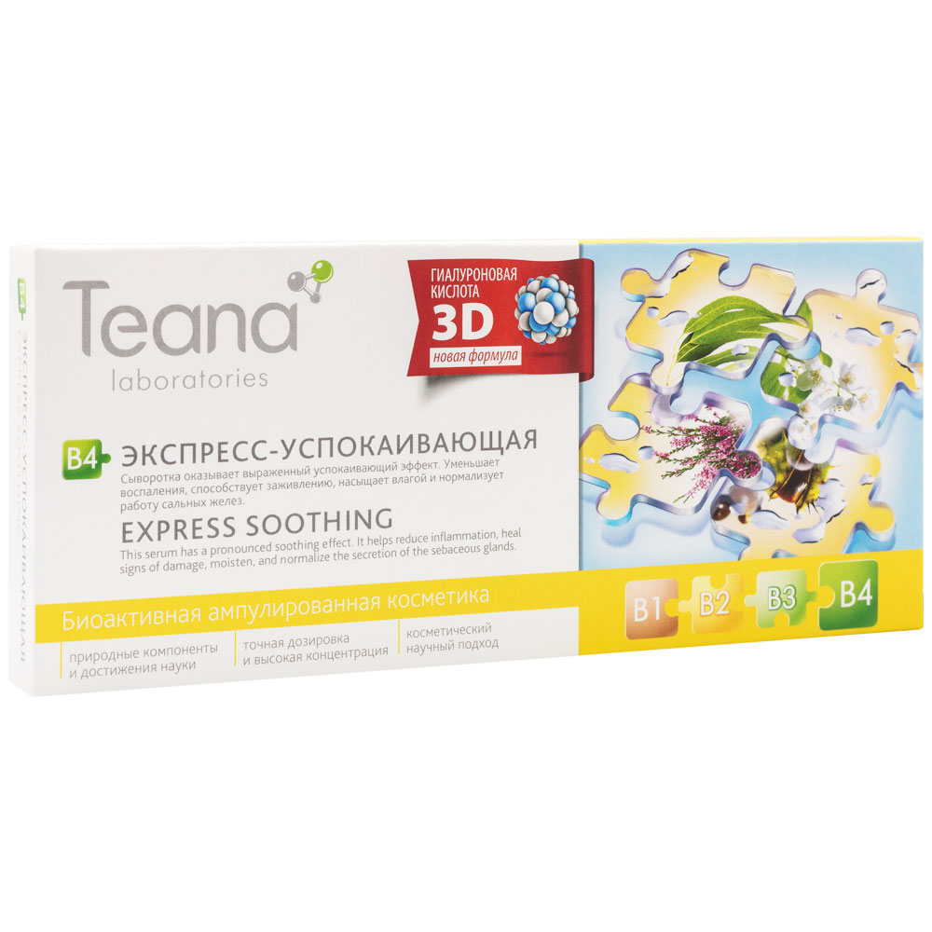
B – Secret of Matte Skin
B4. Express Soothing
Skin type: any type of skin after facials, 16+
Effect: normalizes the secretion of sebaceous glands, effectively treating inflammation and acne, helps restore the skin damaged after peeling and facials.
Ingredients: hyaluronic acid gel (aqua, sodium hyaluronate), sunflower extract (Helianthus annuus), jasmine extract (Jasminum officinale), red clover extract (Trifolium pratense), witch hazel extract (Hamamelis virginiana), almond extract (Prunus amygdalus dulcis), elderberry extract (Sambucus nigra).

Slide 10
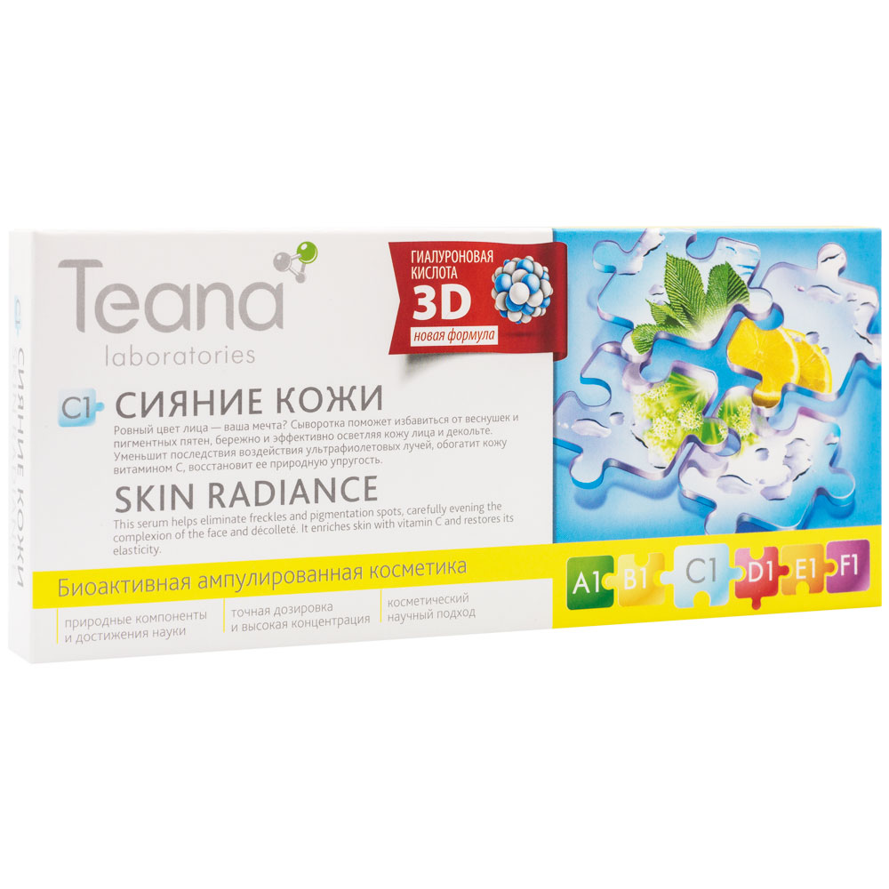
C – Perfect Complexion
C1. Skin Radiance
Skin condition: all skin types with freckles and pigmentation, 18+
Effect: reduces hyperpigmentation and freckles, evens the tone of the skin, improves post acne skin condition.
Ingredients: hyaluronic acid gel (aqua, sodium hyaluronate), bearberry extract (Arctostaphylos uva-ursi), licorice extract (Glycyrrhiza glabra), Chinese angelica extract (Angelica dahurica), dittany bark extract (Dictamnus dasycarpus), lemon extract (Citrus limon).

Slide 11
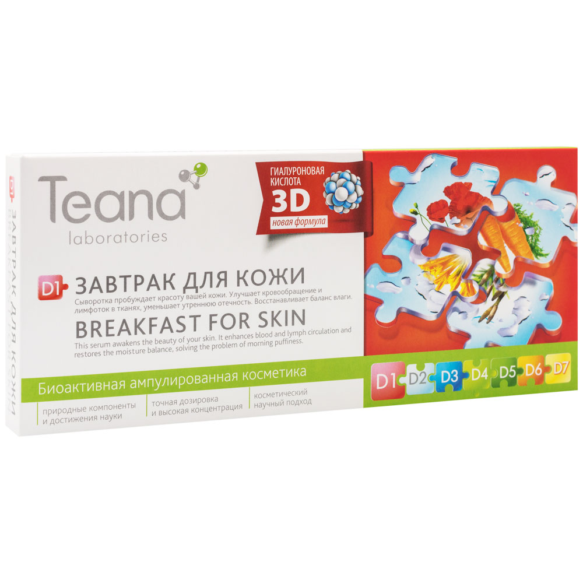
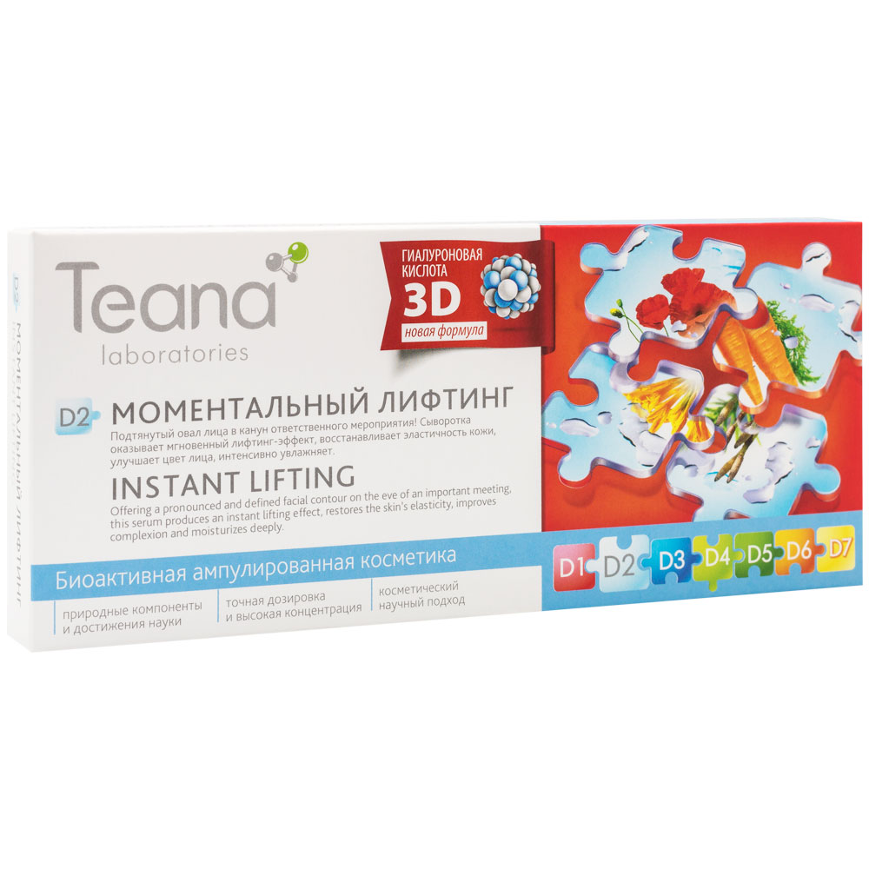
D – Vector of Youth
D1. Breakfast for Skin
Skin condition: prone to puffiness, 30+
Effect: relieves morning puffiness, restores moisture balance, provides a lifting effect, reduces and prevents wrinkles.
Ingredients: hyaluronic acid gel (aqua, sodium hyaluronate), common poppy extract (Papaver rhoeas), common horsetail extract (Equisetum arvense), cornflower extract (Centaurea cyanus), honeysuckle extract (Lonicera caprifolium), arnica extract (Arnica montana).
D2. Instant Lifting
Skin condition: skin of any type with weak facial contour, prone to sagging, 40+ or earlier
Effect: provides an intense lifting effect, helps the contour of the face become more pronounced and defined, quickly tightens the skin.
Ingredients: hyaluronic acid gel (aqua, sodium hyaluronate), witch hazel extract (Hamamelis virginiana), vitamin А (Retinyl palmitate).

Slide 12
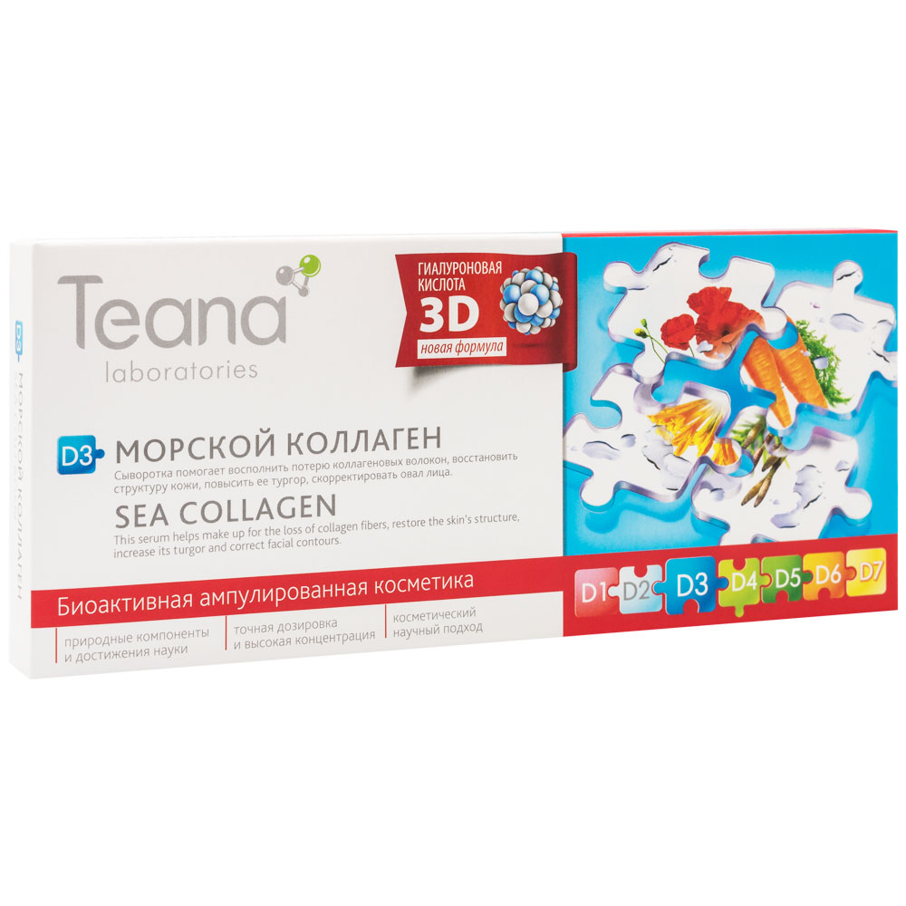
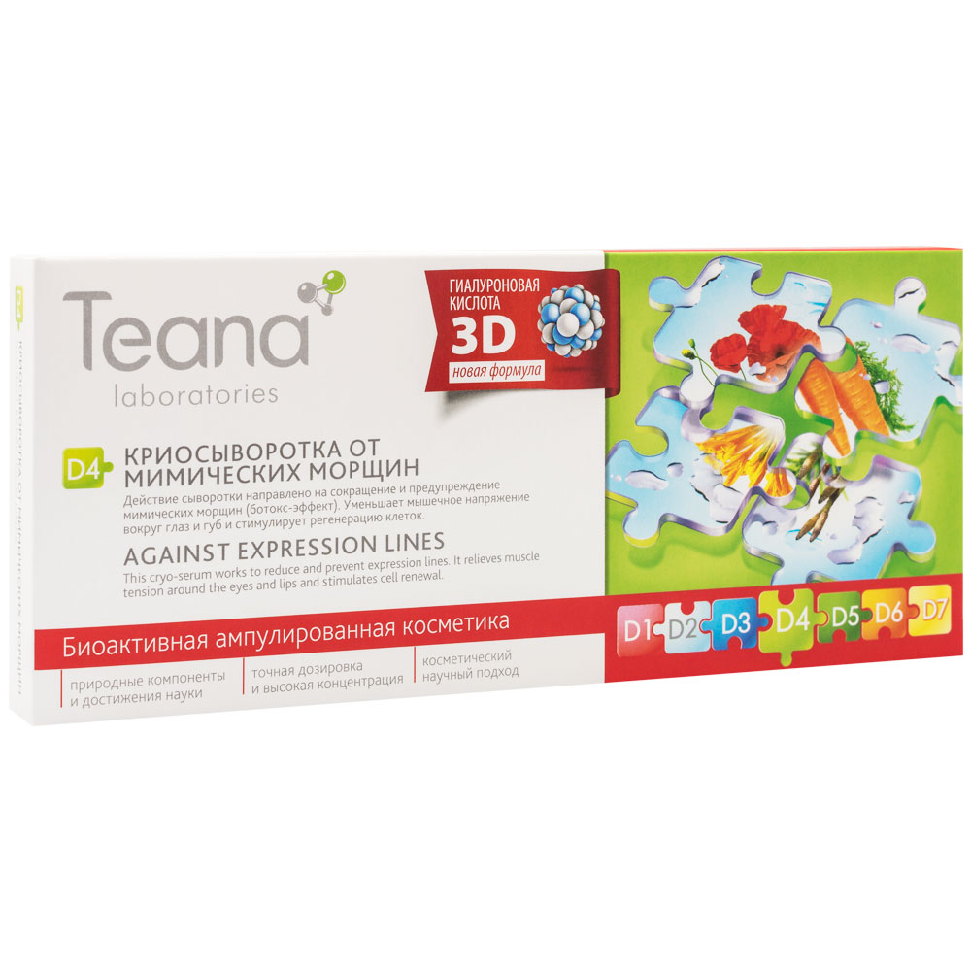
D – Vector of Youth
D3. Sea Collagen
Skin condition: any type with weakened frame and loss of elasticity, 40+ or earlier
Effect: restores skin’s structure, increases turgor
!It is recommended to mix with serum D7 Elastin, as elastin is a superconductor for collagen.
Ingredients: hyaluronic acid gel (aqua, sodium hyaluronate), hydrolyzed collagen, Optiphen BD (Benzyl alcohol, Benzoic acid, Dehydroacetic acid).
D4. Against Expression Lines
Skin condition: dry or dehydrated skin type, 25+
Effect: eliminates and prevents expression lines by relieving muscle tension around the eyes, lips, temple and forehead.
Ingredients: hyaluronic acid gel (aqua, sodium hyaluronate), witch hazel extract (Hamamelis virginiana), vitamin А (Retinyl palmitate), Argireline (Acetyl hexapeptide-8), menthol (Menthol), Optiphen BD (Benzyl alcohol, Benzoic acid, Dehydroacetic acid).

Slide 13
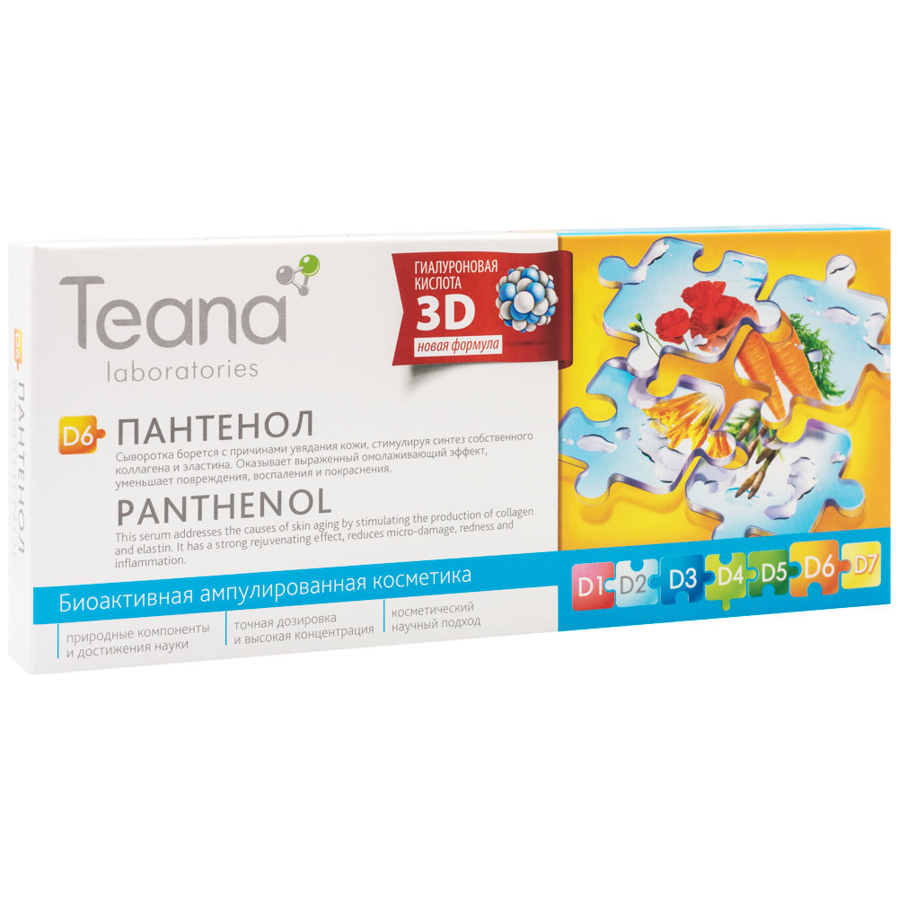
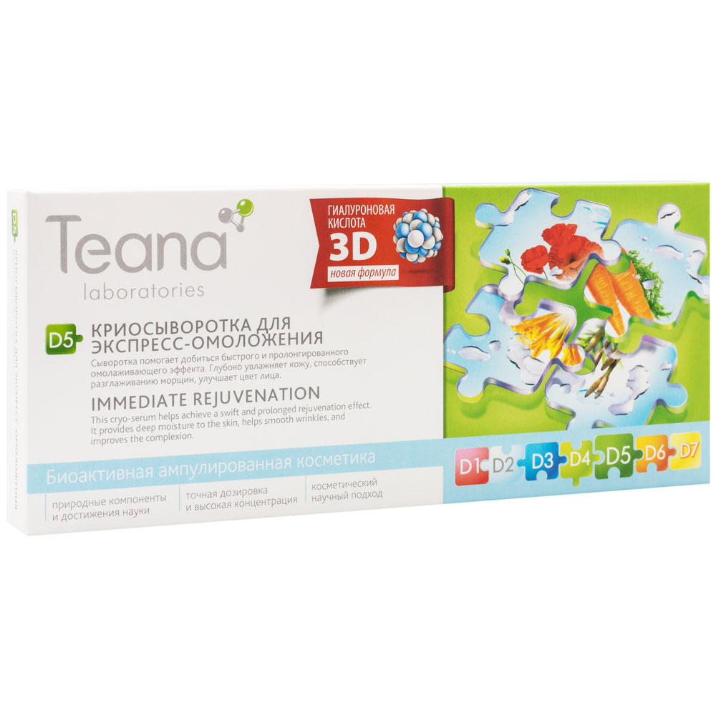
D – Vector of Youth
D5. Immediate Rejuvenation
Skin condition: mature skin of any type, 40+
Effect: provides targeted, deep moisture to the skin, tightens and lifts it, smoothes existing wrinkles and prevents the appearance of new ones, restores elasticity, helps eliminate puffiness.
!We recommend a full course for a prolonged effect
Ingredients: hyaluronic acid gel (aqua, sodium hyaluronate), witch hazel extract (Hamamelis virginiana), vitamin А (Retinyl palmitate), menthol (Menthol), Optiphen BD (Benzyl alcohol, Benzoic acid, Dehydroacetic acid).
D6. Panthenol
Skin condition: all skin types damaged after burns, surgery, injury, and peeling, 16+
Effect: smoothes wrinkles by stimulating the production of collagen and elastin, eliminates micro-damage, redness and inflammation by accelerating cellular metabolism in the epidermis.
Ingredients: hyaluronic acid gel (aqua, sodium hyaluronate), D-panthenol (Panthenol), Optiphen BD (Benzyl alcohol, Benzoic acid, Dehydroacetic acid).

Slide 14
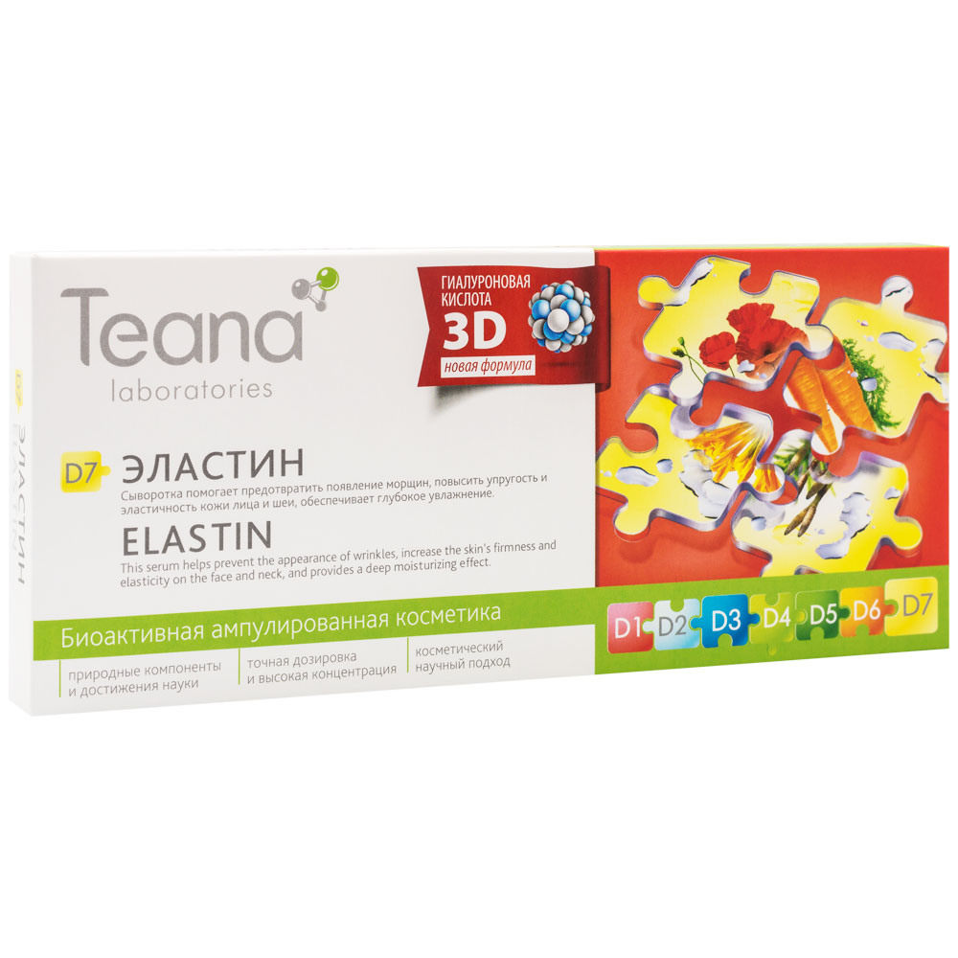
D – Vector of Youth
D7. Elastin
Skin type: mature skin with a lot of small wrinkles, 40+
Effect: smoothes wrinkles and prevents the appearance of new ones, provides long-term moisturizing and firming effect.
!Recommended as a stand alone treatment or combined with D3 serum Sea Collagen and other serums as it acts as conductor for their active ingredients.
Ingredients: hyaluronic acid gel (aqua, sodium hyaluronate), hydrolyzed elastin, Optiphen BD (Benzyl alcohol, Benzoic acid, Dehydroacetic acid).

Slide 15
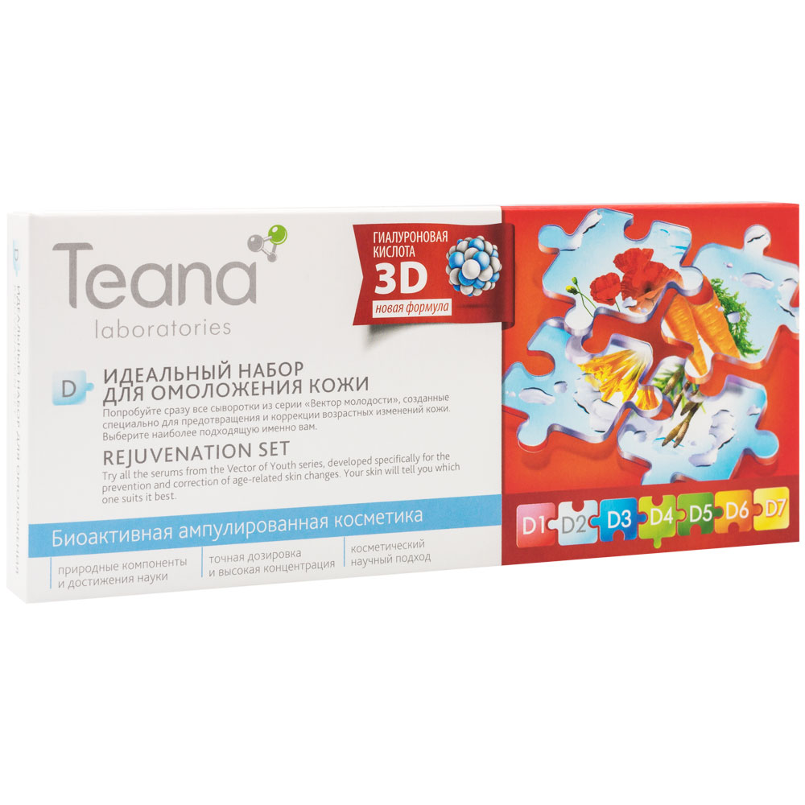
D – Vector of Youth
D. REJUVENATION SET
An ideal opportunity to try the whole line of anti-aging serums developed by Teana laboratories specifically for mature skin and choose the best for the specific individual needs.
contains:
D1. Breakfast for Skin – 2 ampoules
D2. Instant Lifting – 2 ampoules
D3. Sea Collagen – 1 ampoule
D4. Against Expression Lines – 1 ampoule
D5. Immediate Rejuvenation – 1 ampoule
D6. Panthenol – 1 ampoule
D7. Elastin – 2 ampoules

Slide 16
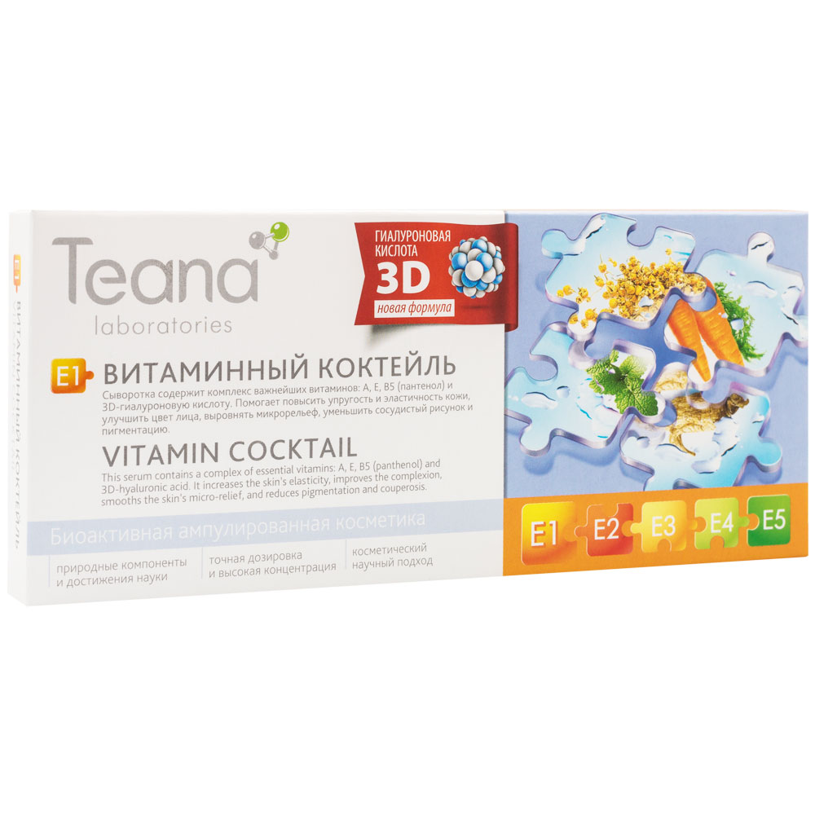
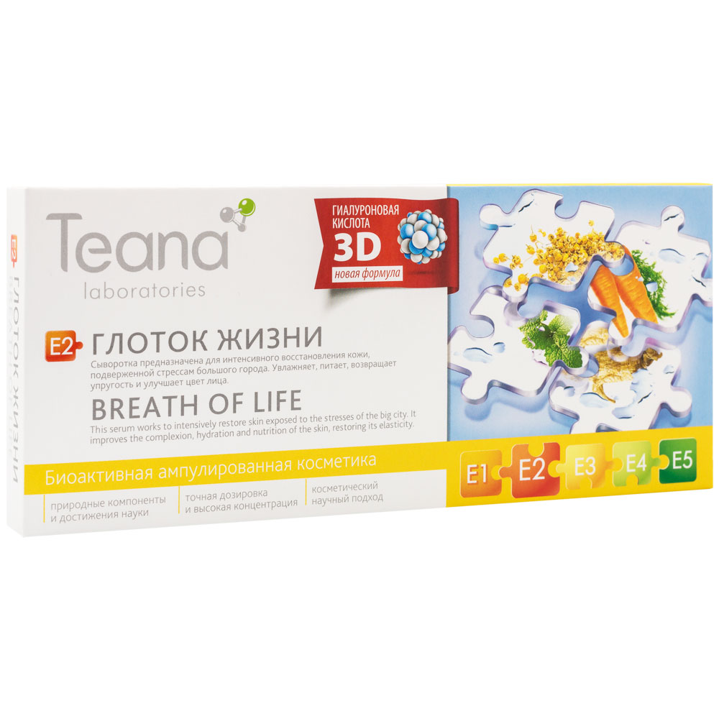
E – Vital Energy
E1. Vitamin Cocktail
Skin condition: all skin types, suffering from seasonal vitamin deficiency or flaking and chapping caused by temperature changes, 20+
Effect: analogue of biorevitalization, evens complexion, smoothes micro-relief, reduces pigmentation and redness, stimulates the natural processes of regeneration.
Ingredients: hyaluronic acid gel (aqua, sodium hyaluronate), vitamin A (Retinyl palmitate), Vitamin E (Tocopheryl acetate), D-panthenol (Panthenol).
E2. Breath of Life
Skin condition: uneven dull complexion of smokers and megacity dwellers, 20+
Effect: improves the complexion, hydration and nutrition of the skin, restoring its elasticity and tenderness.
!Works well in place of CC cream or a foundation, by removing the general redness or dull tone.
Ingredients: hyaluronic acid gel (aqua, sodium hyaluronate), aloe extract (Aloe barbadensis), sage extract (Salvia officinalis), ginseng extract (Panax ginseng), camomile extract (Chamomilla recutita), camel grass extract (Cymbopogon schoenanthus), lemon balm extract (Melissa officinalis), hydrolysed milk protein.

Slide 17
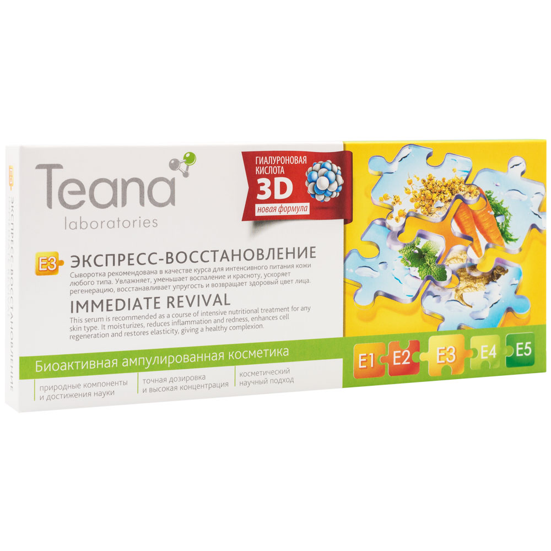
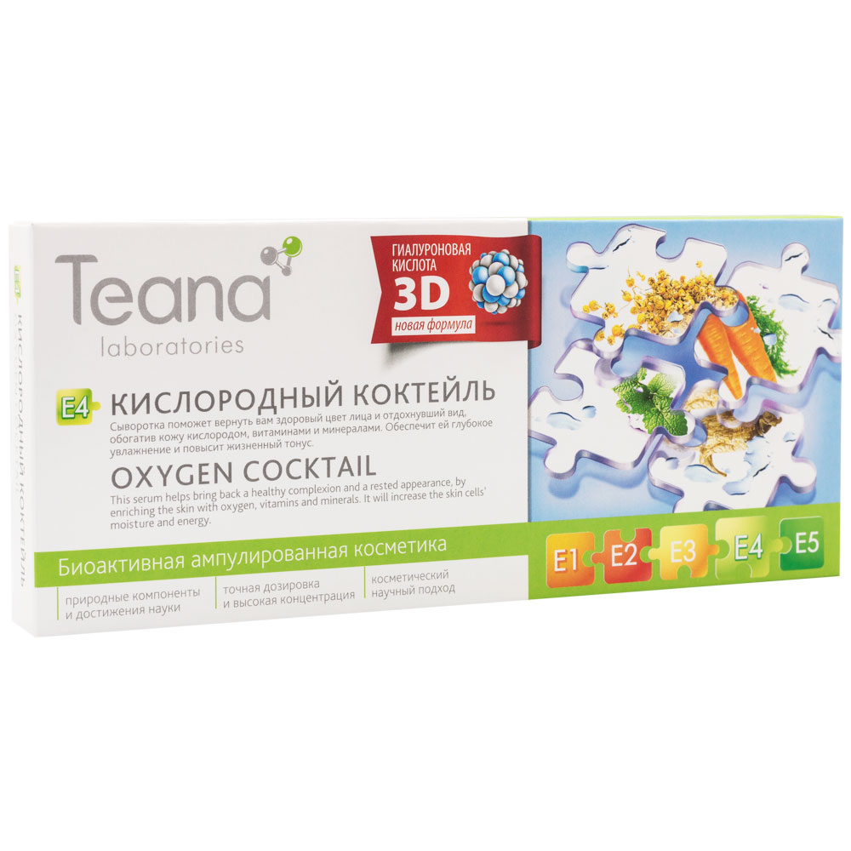
E – Vital Energy
E3. Immediate Revival
Skin condition: lacking nutrition after stress (lack of sleep, taking medication, poor ecology, wrong skincare), 20+
Effect: saturates dehydrated areas with moisture, reduces inflammation and redness, restores elasticity, freshens and improves the complexion.
!The serum has a slightly oily structure, so is ideal as a course of intensive nutritional treatment in the evenings for very dry skin.
Ingredients: hyaluronic acid gel (aqua, sodium hyaluronate), aloe extract (Aloe barbadensis), carrot extract (Daucus carota sativa), frankincense extract (Boswellia carterii), D-panthenol (Panthenol).
E4. Oxygen Cocktail
Skin condition: dull complexion of smokers and office workers,20+
Effect: enriches with oxygen, gives skins a rested appearance, toned and moisturized.
!Ideal for morning care for combination skin with an oily T-zone, thanks to its light texture.
Ingredients: hyaluronic acid gel (aqua, sodium hyaluronate), Irish moss extract (Chondrus crispus)

Slide 18
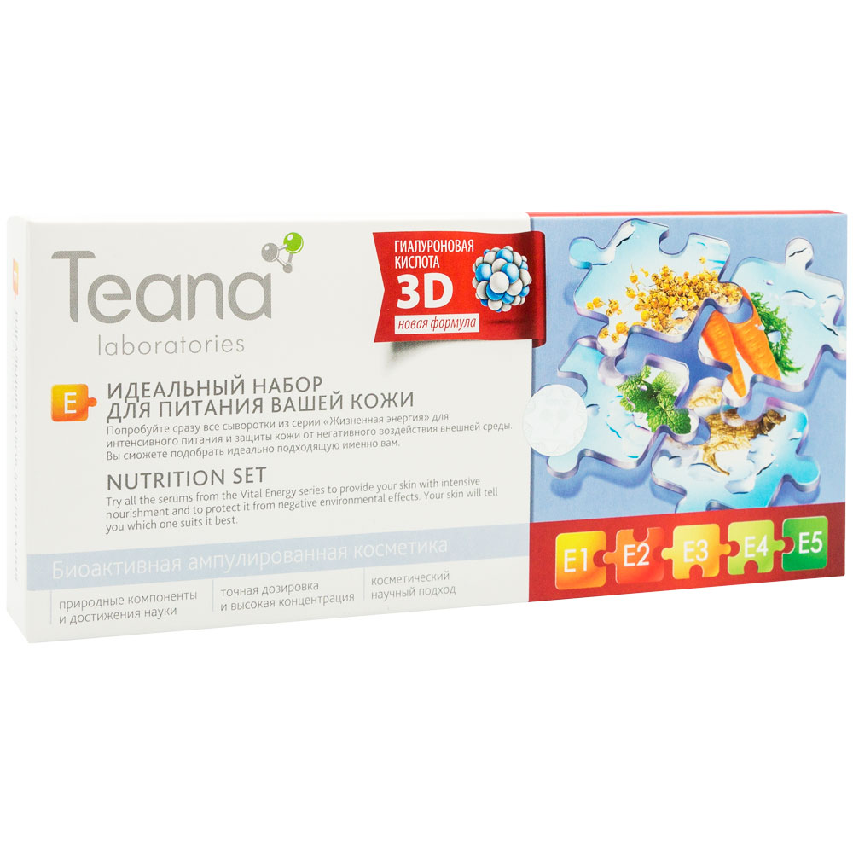
E – Vital Energy
E. SKIN NUTRITION SET
An ideal opportunity to try the whole line of skin nourishing serums at once and choose the best for the specific individual needs.
contains:
E1. Vitamin Cocktail - 3 ampoules
E2. Breath of Life - 2 ampoules
E3. Immediate Revival - 2 ampoules
E4. Oxygen Cocktail - 2 ampoules

Slide 19
FAQ
How long can the serums be stored?
The sealed serums can be stored for 24 months. Opened vials must be stored in refrigerator for no more than 3 days.
How do I apply the serums?
1) Apply straight from the ampoule using your fingertips.
2) Mix with a cream in your palm and apply normally.
How do I open an ampoule?
Place your finger under the arrows on the cap and push it open.
Can I use Teana serums with a dermaroller?
No, because the cosmetics are non-sterile there is the risk that with a dermaroller the ingredients may enter the blood and lead to allergies. All serums can be used with noninvasive cosmetic tools.
Do the serums have any charge?
All our serums are naturally neutral. Their potential is equilibrated, so they are absolutely safe to use with professional non-invasive cosmetic equipment.
I found the sediment at the bottom of the ampoule/ the liquid in a few ampoules of the pack have a different color, is this ok?
Yes. Since the serums are completely natural, this is normal. Just shake the bottle before use.

Slide 20
Teana-team.ru
Teana-labs.ru

