Slide 1
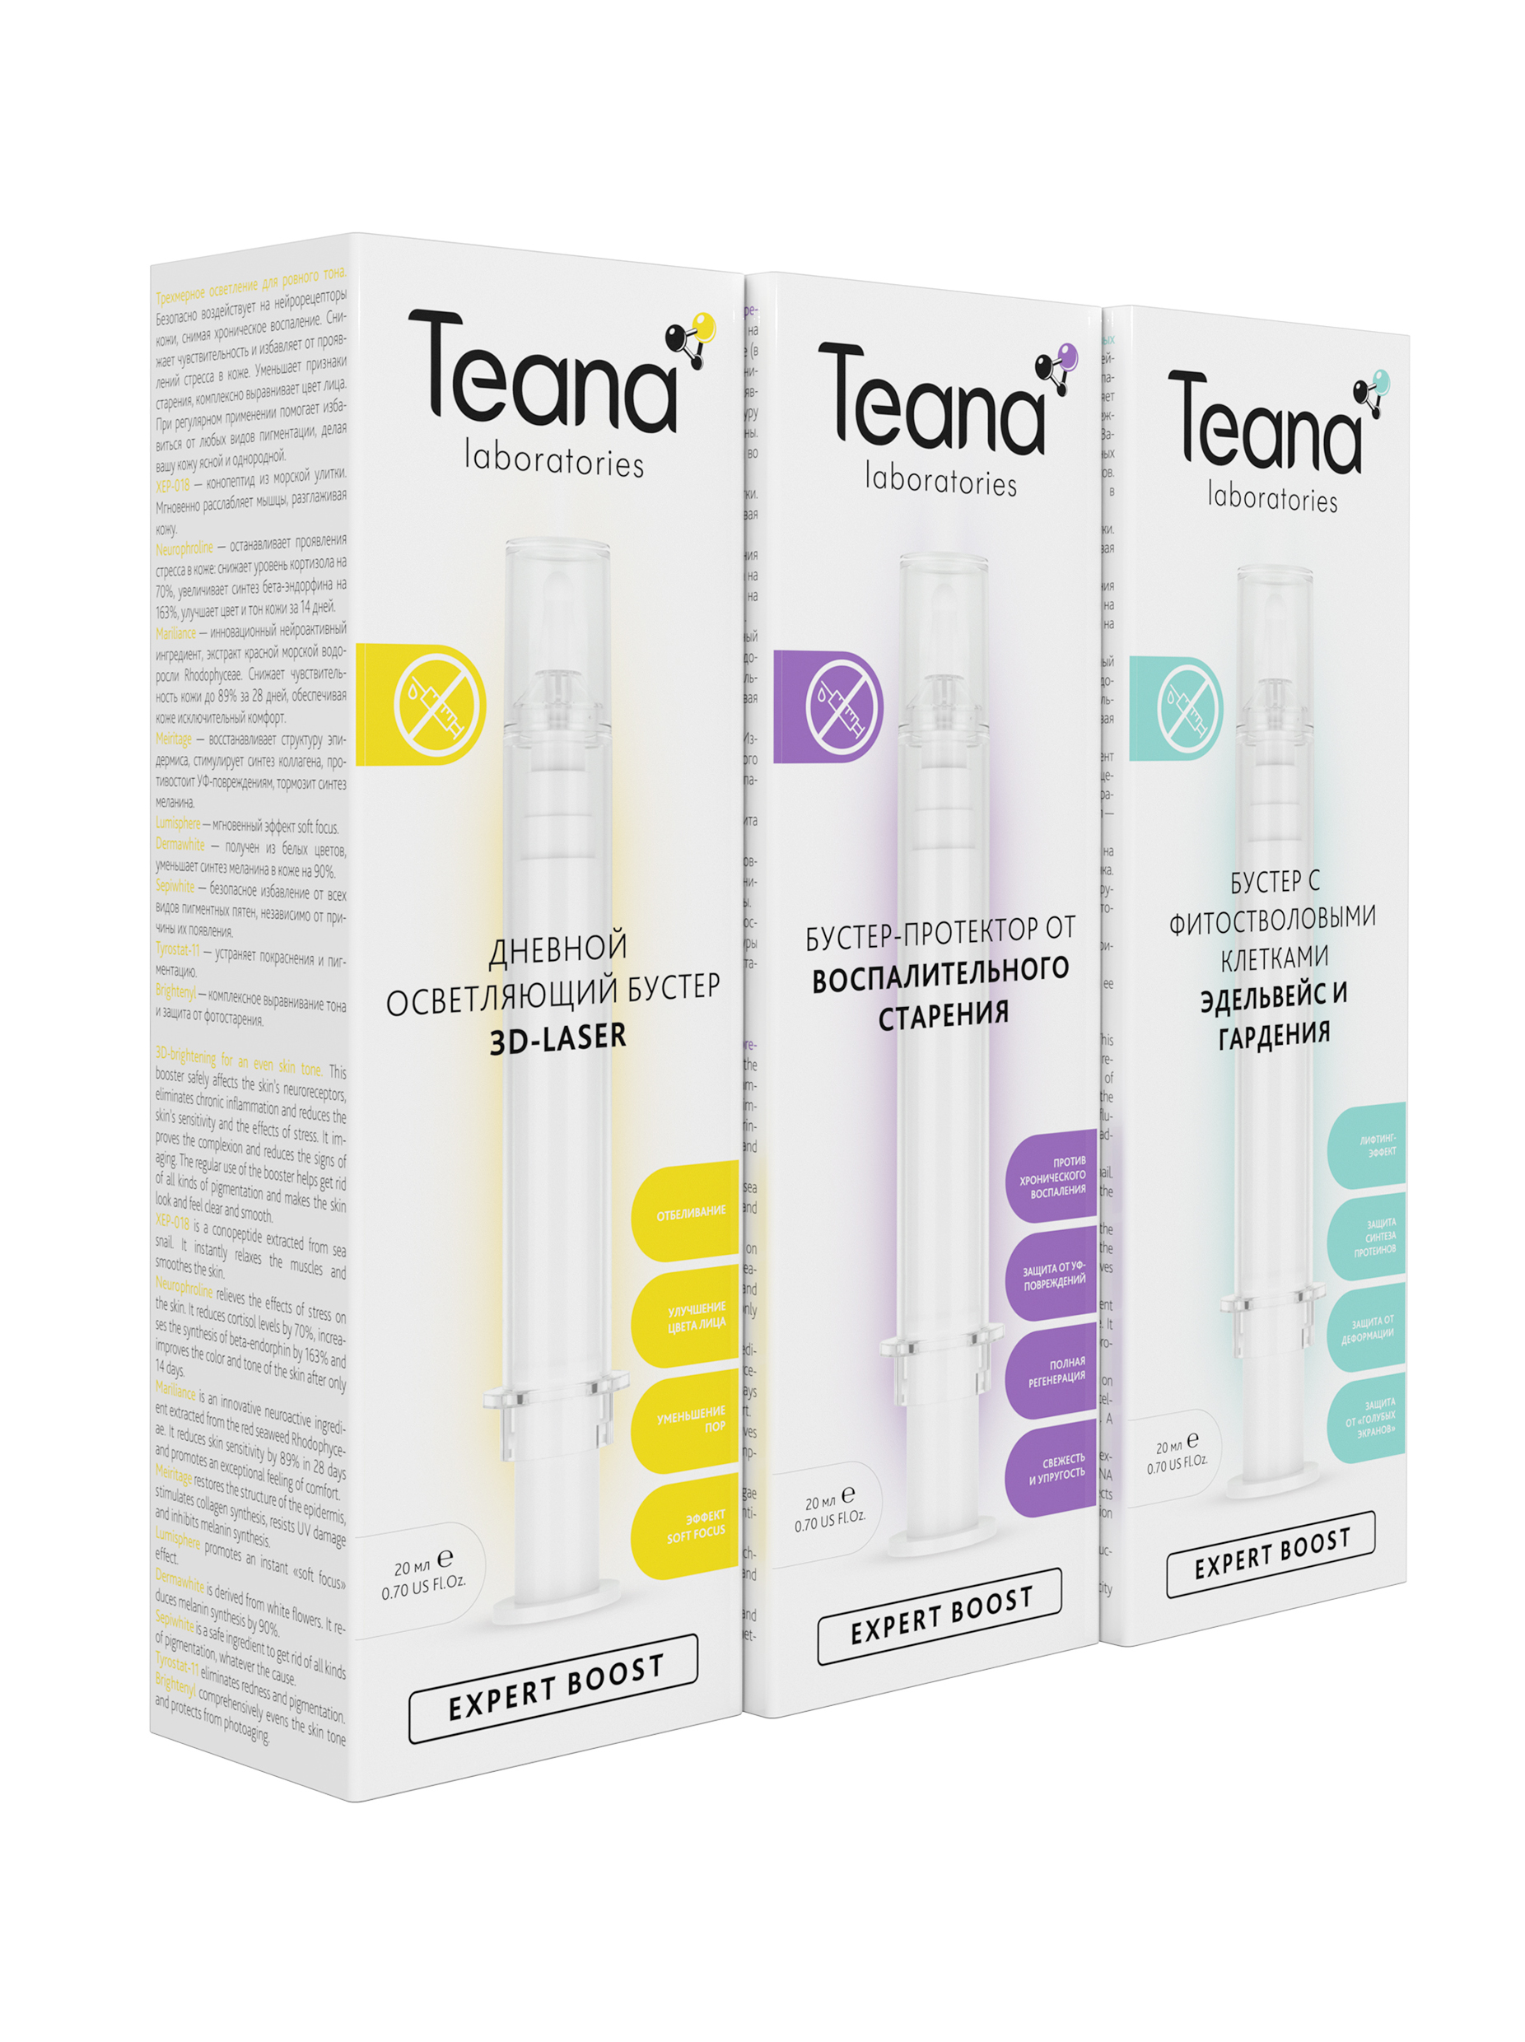
NEUROACTIVE BOOSTERS
A brand new skincare concept

Slide 2
WHAT
A BOOSTER — is a supercharger for any skincare treatment, including serums and creams. This revolutionary highly active product increases the effectiveness of cosmetic bioactive ingredients’ action on the skin. This leads to phenomenal results comparable to beauty salon cosmetology (such as injections, laser rejuvenation, etc.)
HOW
Boosting the effectiveness of any skincare regimen
“Squeezing” the maximum benefit of any skincare product
Highly effective as a stand-alone product or when embedded into a daily routine
Pushing active ingredients deeper into the skin
TURBO EFFECT
BOOSTER+SERUM+CREAM
INTENSIVE CARE
SERUM+CREAM
BASIC CARE
CREAM

Slide 3
BOOSTER COMBINATIONS
BOOSTER
+
SERUM
+
CREAM
BOOSTER
+
SERUM
+
MASK
SERUM
+
BOOSTER
+
CREAM
SERUM
+
BOOSTER
+
MASK
BOOSTER
+
CREAM
BOOSTER
+
MASK
BOOSTER
+
MAKEUP

Slide 4
Teana boosters are a breakthrough in cosmetology. Here is why:
They are based on a brand new technology of skin regeneration and rejuvenation by effecting the skin’s neuroreceptors.
Boosters give a deep, long-term and visible effect without “beauty injections” by optimizing the cells’ functions.
The most pronounced results can be seen on the skin, exposed to chronic stress, damage and aging.
They provide an optimal care for sensitive and reactive skin.
Teana is the first skincare brand, which has launched a wide range of boosters, targeting various skin imperfections and presenting an affordable alternative to beauty salon treatments. Application of just 0,5-1ml per day makes one booster last for 20 to 40 days.
Beauty without wrinkles!
Beauty without stress!
Beauty without skin reactivity!
XEP™-018 is a powerful rejuvenating peptide extracted from sea snail. It instantly relaxes the muscles and smoothes the skin 2 hours after application.
Neurophroline™ relieves the negative effects of stress on the skin. It reduces cortisol levels by 70% and increases the synthesis of beta-endorphin (“happiness hormone”) by 163%, improving the tone of the skin after only 14 days.
Mariliance™ is an innovative neuroactive ingredient extracted from the red seaweed. It reduces skin sensitivity by 89% in 28 days and promotes an exceptional feeling of comfort.

Slide 5
18 boosters Teana Expert Boost — leading to a wow-effect.
ALTERNATIVE TO BEAUTY SALON COSMETOLOGY
• Booster with ionosomes NON-INJECTION FILLING
• Booster for mature skin BLUE RETINOL
• Booster for a non-surgical facelift IDEAL SHAPE
CORRECTION OF SKIN IMPERFECTIONS
• Spider veins corrector MIRABILIS
• Pore minimizing booster INVISIBLE PORES
• Booster for problem skin NATURAL SALICYLIC ACID
INTENSIVE LIGHTENING
• Day brightening booster 3D-LASER
• Night brightening booster ANTI-SPOT
• Hand & decollete anti-spot booster WHITE TURMERIC
PROTECTION FROM THE MAIN CAUSES OF AGING
• Day brightening booster SPF 30 TOTAL PROTECTION
• Mineral energizing booster for tired skin STOP-STRESS
• Booster against glycation GLYCO-STOP
• Protecting booster ANTI-INFLAMMAGING
• Booster with boreal wood extracts EXTREME CARE
STRENGTHENING THE SKIN’S STRUCTURE AND ANTI-AGE CARE
• Luxurious anti-aging booster WHITE TRUFFLE
• Booster with phyto stem cells ELDERFLOWER & GARDENIA
• Silicon booster THE RESTRUCTURIZER
EYEBROWS AND LASHES GROWTH
• Lash & brow booster LARIX AND TEA PLANT

Slide 6
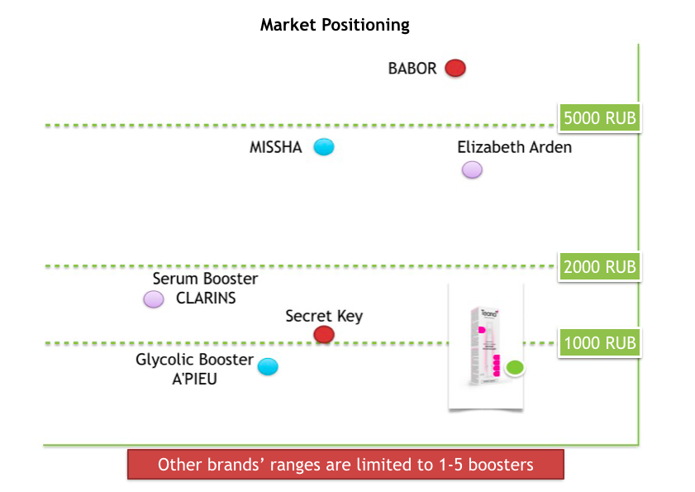

Slide 7
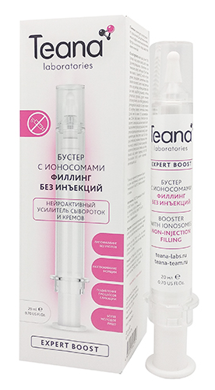
Alternative to beauty salon cosmetology
BOOSTER WITH IONOSOMES NON-INJECTION FILLING
An innovative technology for lipofilling without injections
Correcting age-related changes by safely increasing the fatty tissues where needed;
Reducing nasolabial folds and improving the face contours;
Slowing down skin aging, caused by glycation (conglutination of collagen and elastin molecules by glucose);
Making the skin more taut and smooth, reducing the appearance of wrinkles.
Active ingredients: XEP-018, Neurophroline, Mariliance, Adipofill’in, Kombuchka, Volufiline.
Skin type: any

Slide 8
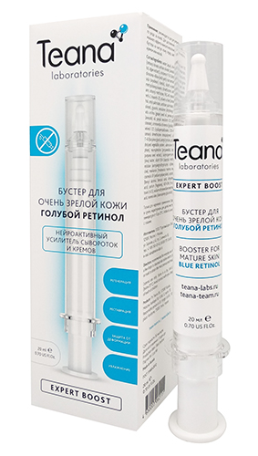
Alternative to beauty salon cosmetology
BOOSTER FOR MATURE SKIN BLUE RETINOL
The benefits of retinol without the irritation caused by conventional retinol
Smoothing the skin’s tone and texture similarly to regular retinol but without the side effects such as dryness, erythema, flaking or itching;
Regenerating and rejuvenating the skin on the cell level;
Reducing pigmentation and blurring skin defects;
Moisturizing, smoothing wrinkles.
Active ingredients: XEP-018, Neurophroline, Mariliance, Lanablue, Unisteron Y-50, Unirepair Е-43, Relistase.
Skin type: any

Slide 9
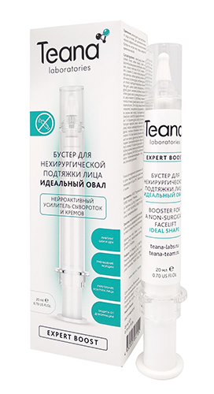
Alternative to beauty salon cosmetology
BOOSTER FOR A NON-SURGICAL FACELIFT IDEAL SHAPE
A phenomenal facelift without a surgery
Lifting the skin in the neck and cheek area;
Firming the jawline, bringing back a more harmonious contour in just 3 weeks;
Stimulating lipolysis, reducing the appearance of the “double chin”;
Smoothing wrinkles, slowing down photo-aging.
Active ingredients: XEP-018, Neurophroline, Mariliance, Slim-Excess, Unisteron Y-50, Unirepair Е-43, Relistase, Majestem.
Skin type: any

Slide 10
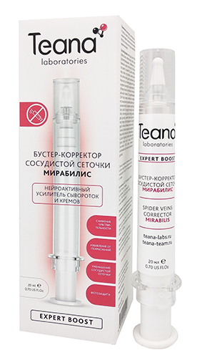
Correction of skin imperfections
SPIDER VEINS CORRECTOR MIRABILIS
An anti-couperosis solution based on Mirabilis extract
Regulating the connection between the epidermis and the nerve endings, reducing the skin’s reactivity and sensitivity;
Decreasing the number of dilated vessels, preventing the formation of new ones;
Reducing inflammation, making the skin more even and tranquil;
Protecting from UV damage.
Active ingredients: XEP-018, Neurophroline, Mariliance, Endothelyol, Pacifeel (mirabilis extract), Telangyn.
Skin type: prone to couperosis, sensitive. Suitable for both young and mature skin.

Slide 11
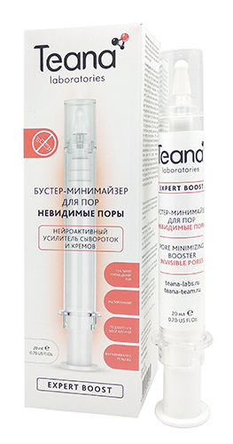
Correction of skin imperfections
PORE MINIMIZING BOOSTER INVISIBLE PORES
A noticeable reduction in pore size
Reducing the size and visibility of pores;
Mattifying the skin throughout the day;
Providing an anti-inflammation and anti-bacterial effect;
Promoting faster healing and regeneration.
Active ingredients: XEP-018, Neurophroline, Mariliance, Epidermist, EPS Seamat, extracts of horse chestnut, nettle and eucalyptus.
Skin type: any, especially combination and oily skin with enlarged pores.

Slide 12
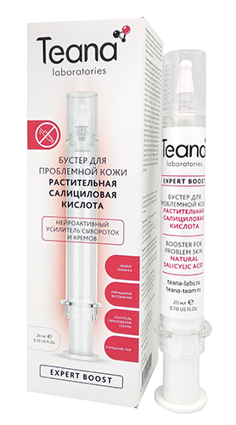
Correction of skin imperfections
BOOSTER FOR PROBLEM SKIN NATURAL SALICYLIC ACID
A natural alternative to synthetic salicylic acid
Reducing chronic inflammation, preventing the development of acne;
Cleansing and narrowing pores;
Gently exfoliating the dead cells without irritating the skin;
Helping the skin become cleaner, smoother and healthier.
Active ingredients: XEP-018, Neurophroline, Mariliance, Amiperfect (natural salicylic acid extracted from Gaultheria).
Skin type: problem, oily and combination skin. Suitable for both young and mature skin.

Slide 13
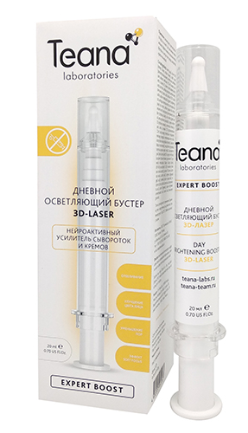
Intensive lightening
DAY BRIGHTENING BOOSTER 3D-LASER
3D-brightening for an even skin tone
Helping get rid of all kinds of pigmentation;
Evening out the skin tone;
Reducing the visibility of pores;
Giving an instant “soft focus” effect.
Active ingredients: XEP-018, Neurophroline, Mariliance, Meiritage, Lumisphere, Dermawhite, Sepiwhite, Tyrostat-11, Brightenyl.
Skin type: any

Slide 14
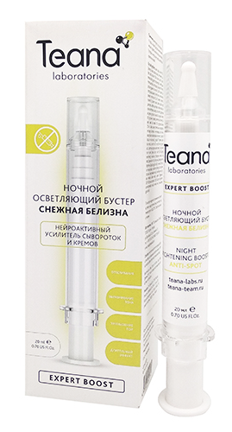
Intensive lightening
NIGHT BRIGHTENING BOOSTER ANTI-SPOT
Evening your skin tone while you are asleep
Helping get rid of all kinds of pigmentation;
Having a powerful antioxidant effect on the skin, restoring it while you sleep;
Giving anti-inflammation and rejuvenating effects;
Smoothing the skin tone, reducing the size of pores.
Active ingredients: XEP-018, Neurophroline, Mariliance, Boréaline Protect, Meiritage, Dermawhite, Tyrostat-11, Brightenyl, Sepiwhite.
Skin type: any

Slide 15
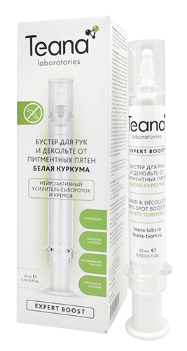
Intensive lightening
HAND & DECOLLETE ANTI-SPOT BOOSTER
WHITE TURMERIC
Your hands and décolleté will be worthy of a magazine cover
Effectively lightening all kinds of pigmentation;
Bringing back the skin’s smoothness and elasticity;
Firming the skin, reducing stretch marks;
Instantly softening the skin and evening its tone.
Active ingredients: XEP-018, Neurophroline, Mariliance, Lumiskin, SabiWhite (colorless turmeric extract), B-White, Exo-T, Lumisphere.
Skin type: any

Slide 16
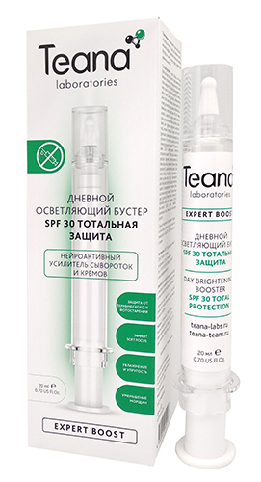
Protection from the main causes of aging
DAY BRIGHTENING BOOSTER SPF 30 TOTAL PROTECTION
Innovative protection from photo and thermal aging of the skin
Providing a powerful protection from the negative effect of UV and infrared radiation;
Reducing the visible signs of skin aging;
Smoothing wrinkles and giving an instant “soft focus” effect;
Lightening the skin, evening its tone.
Active ingredients: XEP-018, Neurophroline, Mariliance, Elix-IR, Caspaline 14, Solaveil XT-300, Uvinul Easy, Lumisphere.
Skin type: any

Slide 17
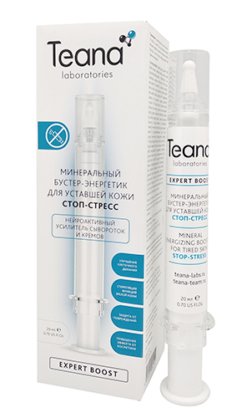
Protection from the main causes of aging
MINERAL ENERGIZING BOOSTER FOR TIRED SKIN
STOP-STRESS
A powerful energy treatment for the skin with valuable minerals
Wiping away the signs of fatigue, filling the skin with energy;
Improving cellular respiration, refreshing the complexion;
Protecting from stress, pollution and other negative external factors;
Firming mature skin, making it more supple and resistant to deformation.
Active ingredients: XEP-018, Neurophroline, Mariliance, Boréaline Protect, Meiritage, Dermawhite, Tyrostat-11, Brightenyl, Sepiwhite.
Skin type: any

Slide 18
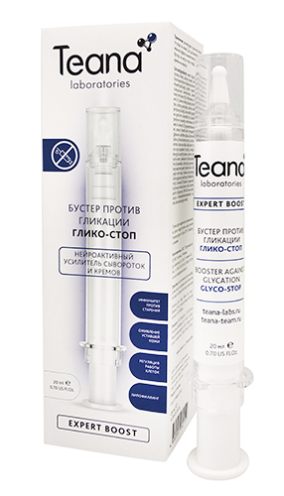
Protection from the main causes of aging
BOOSTER AGAINST GLYCATION GLYCO-STOP
Victory over glyco-aging
Slowing down the skin aging, caused by glycation (conglutination of collagen and elastin molecules by glucose);
Correcting nasolabial folds, increasing the number of adipocytes in the deficient areas;
Firming and rejuvenating mature skin;
Reducing the effects of stress on the skin, such as sensitivity, wrinkles, signs of fatigue.
Active ingredients: XEP-018, Neurophroline, Mariliance, Kombuchka, Resistem, Prodizia, Unisteron Y-50, Unirepair Е-43, Relistase.
Skin type: any

Slide 19
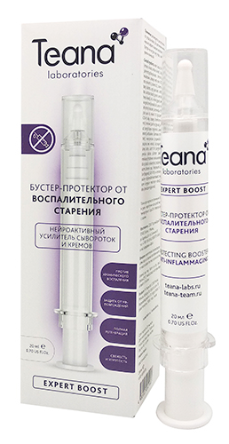
Protection from the main causes of aging
PROTECTING BOOSTER ANTI-INFLAMMAGING
An effective anti-inflammatory solution to prevent skin aging
Reducing chronic inflammation, even asymptomatic, caused by stress;
Launching skin regeneration processes during sleep, visibly rejuvenating it;
Correcting even deep wrinkles;
Protecting from UV damage.
Active ingredients: XEP-018, Neurophroline, Mariliance, Timecode, Antileukine 6, Celtosome, Prodizia.
Skin type: any

Slide 20
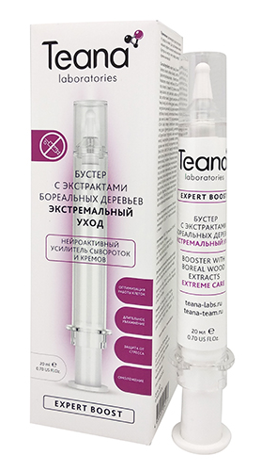
Protection from the main causes of aging
BOOSTER WITH BOREAL WOOD EXTRACTS
EXTREME CARE
Maximum protection based on molecules-extremolytes
Protecting the skin from the extreme stress and damage thanks to unique “antifreeze” proteins and molecules-extremolytes;
Reducing inflammation and irritation and making the skin less sensitive;
Providing long-term hydration;
Activating the cells’ “youthful” functions, promoting a fast visible rejuvenation effect.
Active ingredients: XEP-018, Neurophroline, Mariliance, Antarcticine, Glycoin, Ectoin, Boréaline Expert, Boréaline hydra, Juvenessence.
Skin type: any

Slide 21
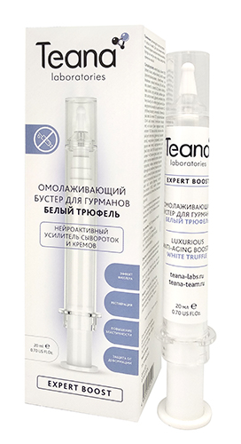
Strengthening the skin’s structure and anti-age care
LUXURIOUS ANTI-AGING BOOSTER WHITE TRUFFLE
Rejuvenation and filling based on white truffle extract
Filling the lines and minor imperfections, smoothing the skin;
Moisturizing intensively and reducing wrinkles;
Reducing puffiness in the eye area;
Strengthening the skin, protecting it from age-related deformation.
Active ingredients: XEP-018, Neurophroline, Mariliance, W Tr-Active (white truffle extract), Unisteron Y-50, Unirepair Е-43, Relistase.
Skin type: any

Slide 22
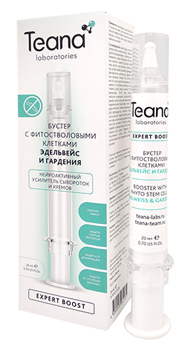
Strengthening the skin’s structure and anti-age care
BOOSTER WITH PHYTO STEM CELLS
ELDERFLOWER & GARDENIA
Phyto stem cells promoting skin longevity
Stimulating self-renewal and self-rejuvenation processes in the skin, fighting with sagging;
Giving an overall lifting effect and smoothing wrinkles;
Enhancing the synthesis of collagen and elastin, strengthening the skin;
Protecting the skin from stress and the negative influence of computer and TV displays and other gadgets.
Active ingredients: XEP-018, Neurophroline, Mariliance, Majestem, Senestem, Gardenia Stems GX, Relistase.
Skin type: any

Slide 23
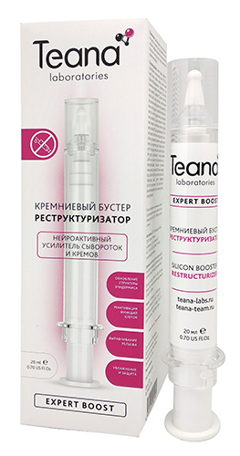
Strengthening the skin’s structure and anti-age care
SILICON BOOSTER THE RESTRUCTURIZER
Smoothing deep wrinkles.
Improving the skin’s protective functions and eliminating the signs of damage thanks to the silicon derivatives in the booster formula;
Protecting collagen and elastin fibers from destruction;
Firming thin fragile skin;
Eliminating the visible signs of aging, caused by stress and environmental factors.
Active ingredients: XEP-018, Neurophroline, Mariliance, Algisium, Epidermosil, Essenskin.
Skin type: any

Slide 24
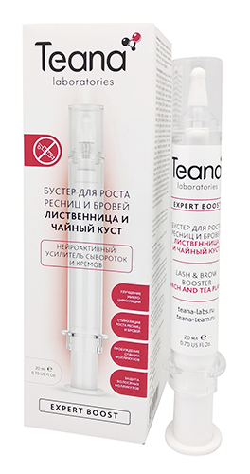
Eyebrows and lashes growth
LASH & BROW BOOSTER LARIX AND TEA PLANT
Activating the growth of eyebrows and lashes
Curing the hair follicles’ damage and inflammation, caused by stress;
Activating “dormant” hair follicles, making eyebrows and lashes grow thicker;
Improving microcirculation, stimulating the growth of healthy and shiny eyebrows and lashes.
Active ingredients: XEP-018, Neurophroline, Mariliance, Redensyl, Procapil.
Skin type: any

Slide 25
User instructions
Logistics information
Apply a few drops to cleansed skin before serum, cream or mask. Or mix 2-3 drops with any skincare product n your palm and apply as usual.
Volume: 20ml
Pieces in carton: 21
Made in: Russia
Shelf life: 36 months
Full carton weight: 2,3 kg
Full carton size: 36*21*21 cm

Slide 26
+7 495 150-03-63
+8 800 775-36-91
teana-team.ru
sales@teana-labs.ru salon@teana-labs.ru

